Slide 1
2004 Cross-shelf

Slide 2
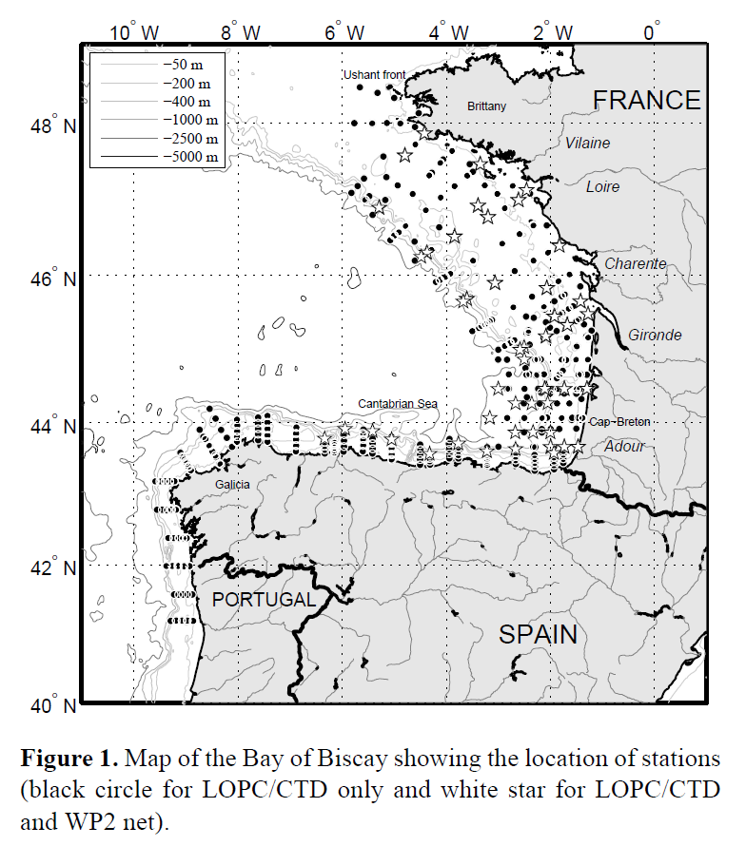
Vandromme 2014 summary
LOPC attached to CTD Rosette, sampled downward casts
Depth integrated samples
> 700 casts in spring (2005 – 2012) in Bay of Biscay
Large focus on comparing LOPC to net samples

Slide 3
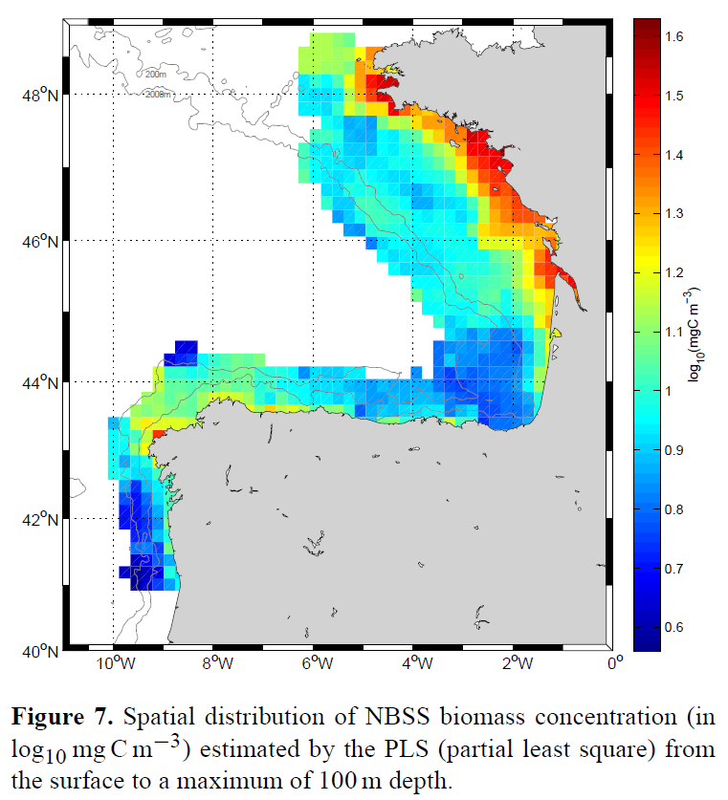
Vandromme 2014 summary
Biomass has strong spatial patterns
High in NE coastal area, low in SE coastal area
Onshore-Offshore gradient

Slide 4
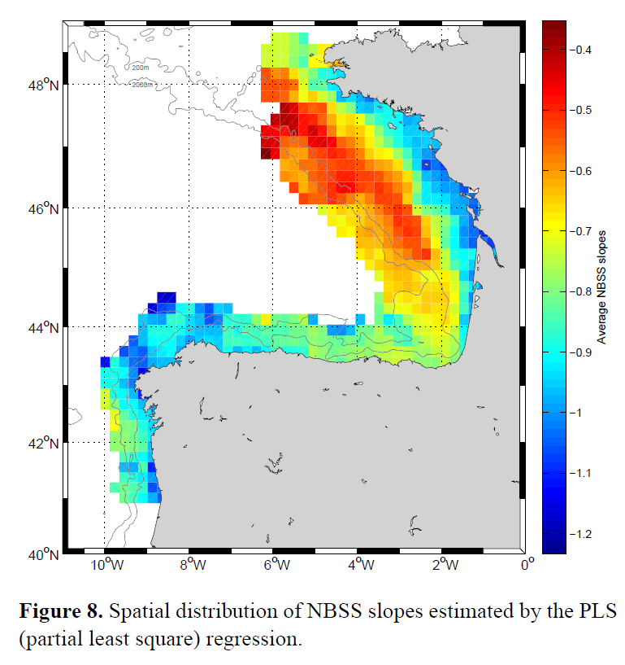
Vandromme 2014 summary
NBSS shows similar spatial patterns to Biomass
Steep slope in NE with offshore gradient to very shallow
Less of a gradient in SE

Slide 5
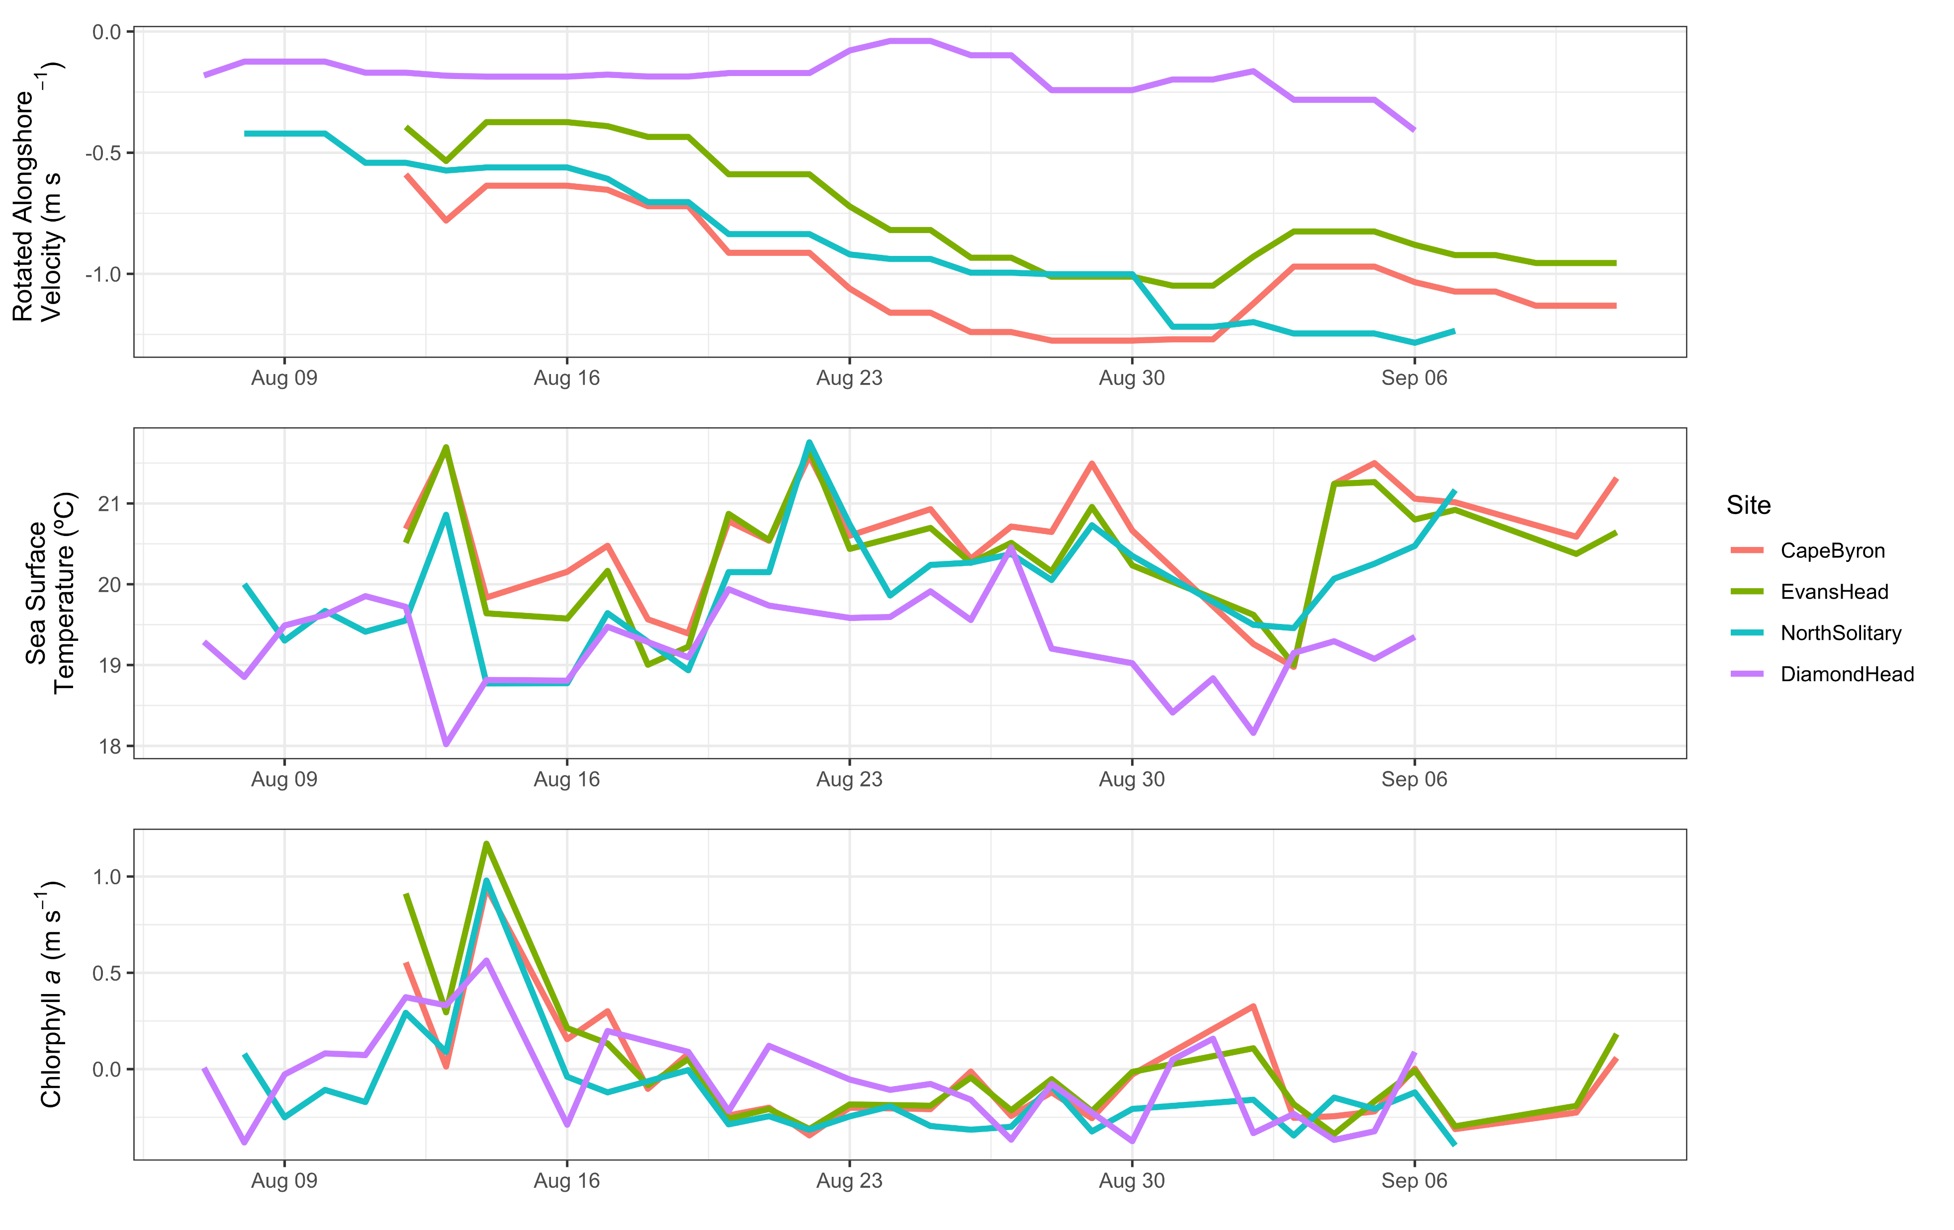
Diamond Head =
Low southward flow
Colder
Similar Chlorophyll a

Slide 6
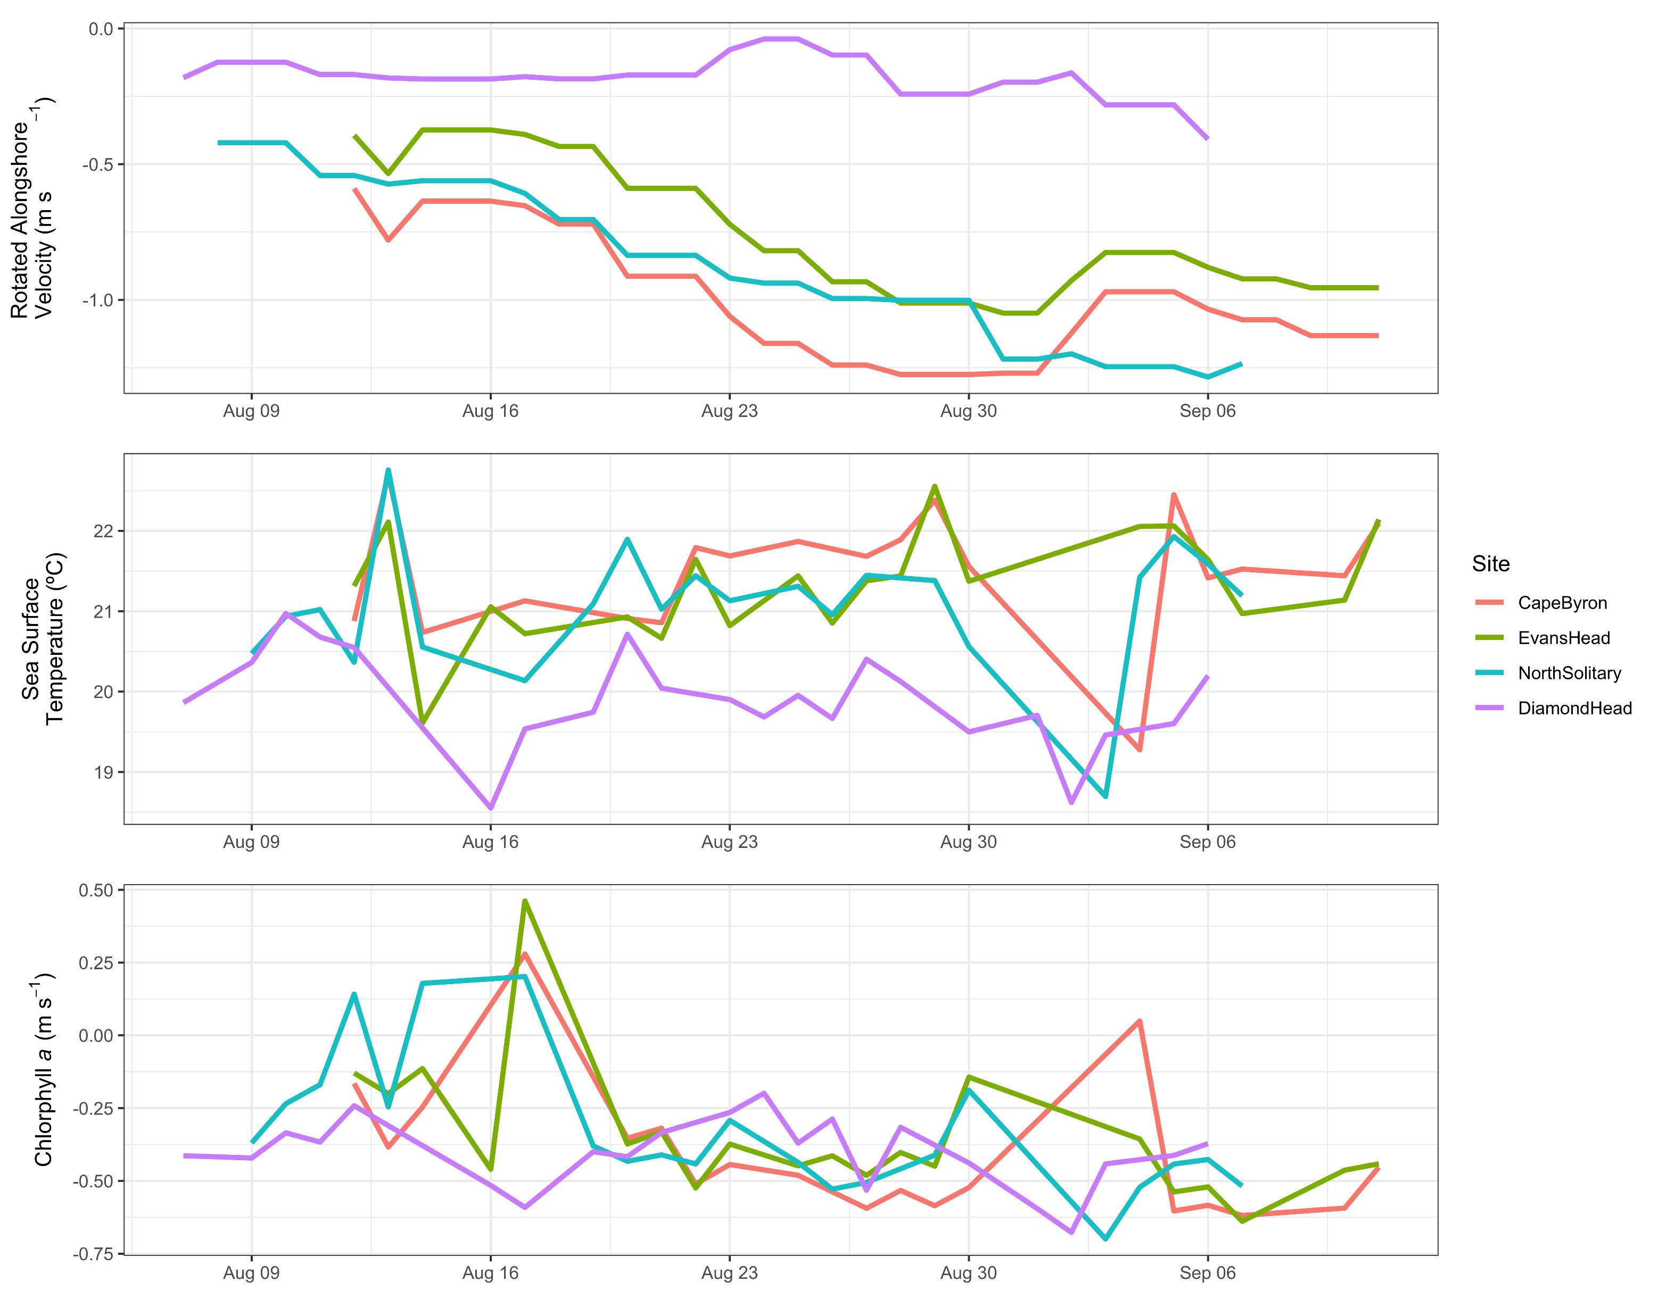
Smaller pixel size
More Chl-a variability
Cape Byron temp drops then back up before sampling
Corresponding changes in velocity and chl-a

Slide 7
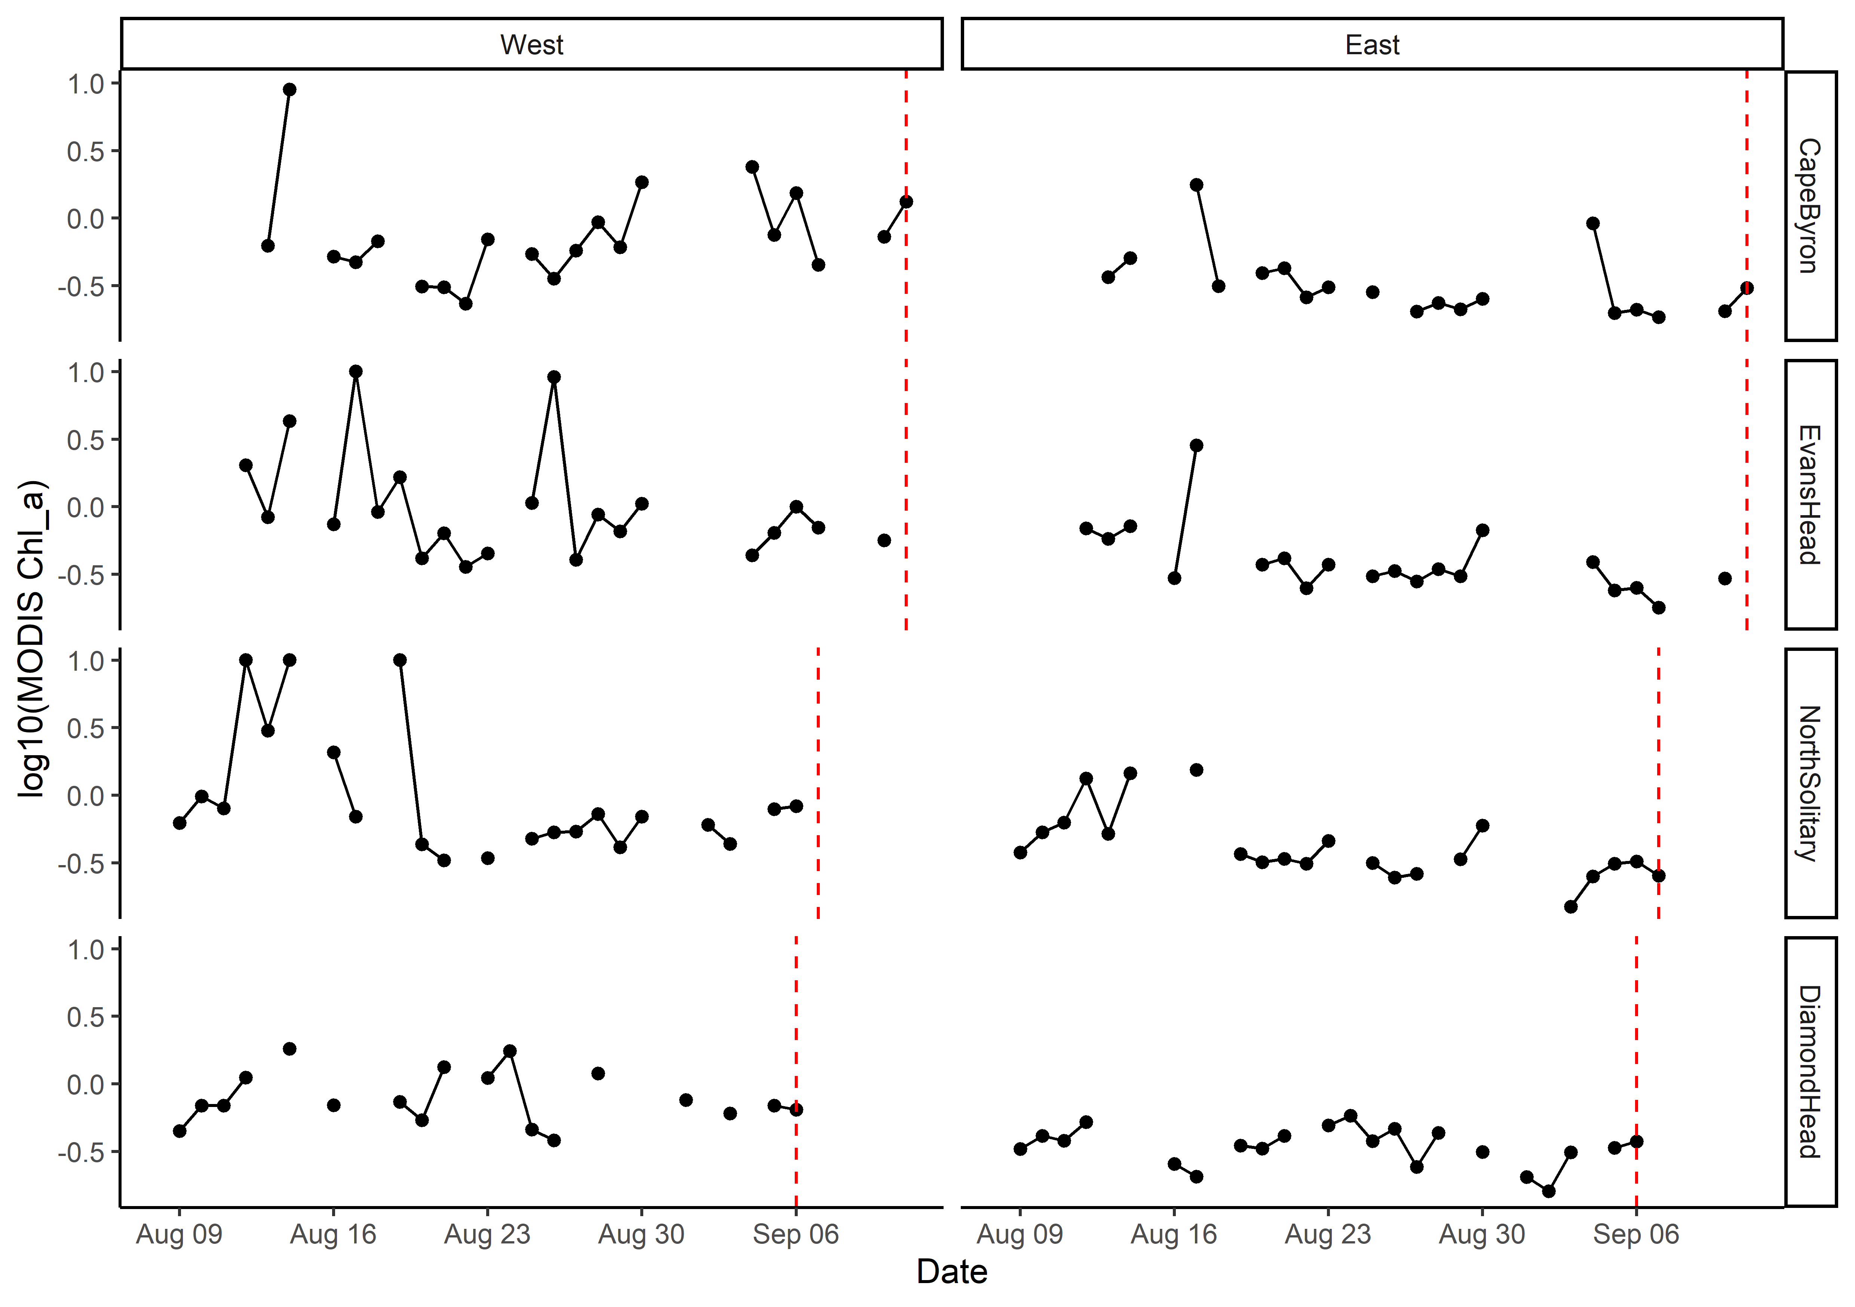
MODIS Chlorophyll a with gaps
Values >10 rescaled to be = 10
Log₁₀ transformed

Slide 8
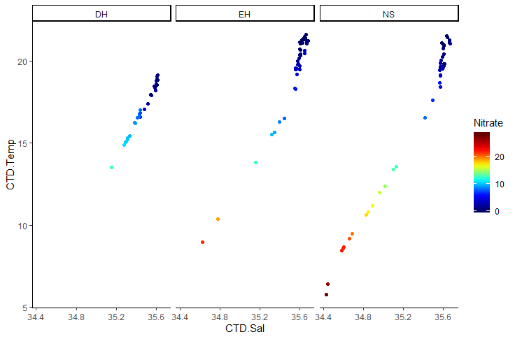
T-S Plot all depths (CTD)

Slide 9
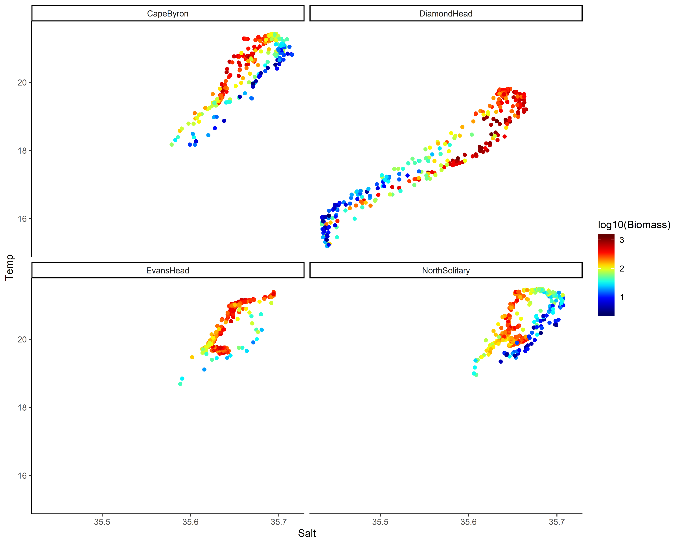
TS Plot by log₁₀(Biomass)

Slide 10
Key Questions
Aim: Describe the water and zooplankton characteristics across the East Australian shelf.
Water characteristics – physical oceanography
Zooplankton characteristics
Are they linked?
What is the larger context of these transects?

Slide 11
Water Characteristics
3 Transects go from inshore to EAC
Diamond Head is in a separation zone
See V-rotated velocities and Temperature
2 types of water mass, EAC influenced and separation zone
Compare northern 3 to Diamond Head

Slide 12
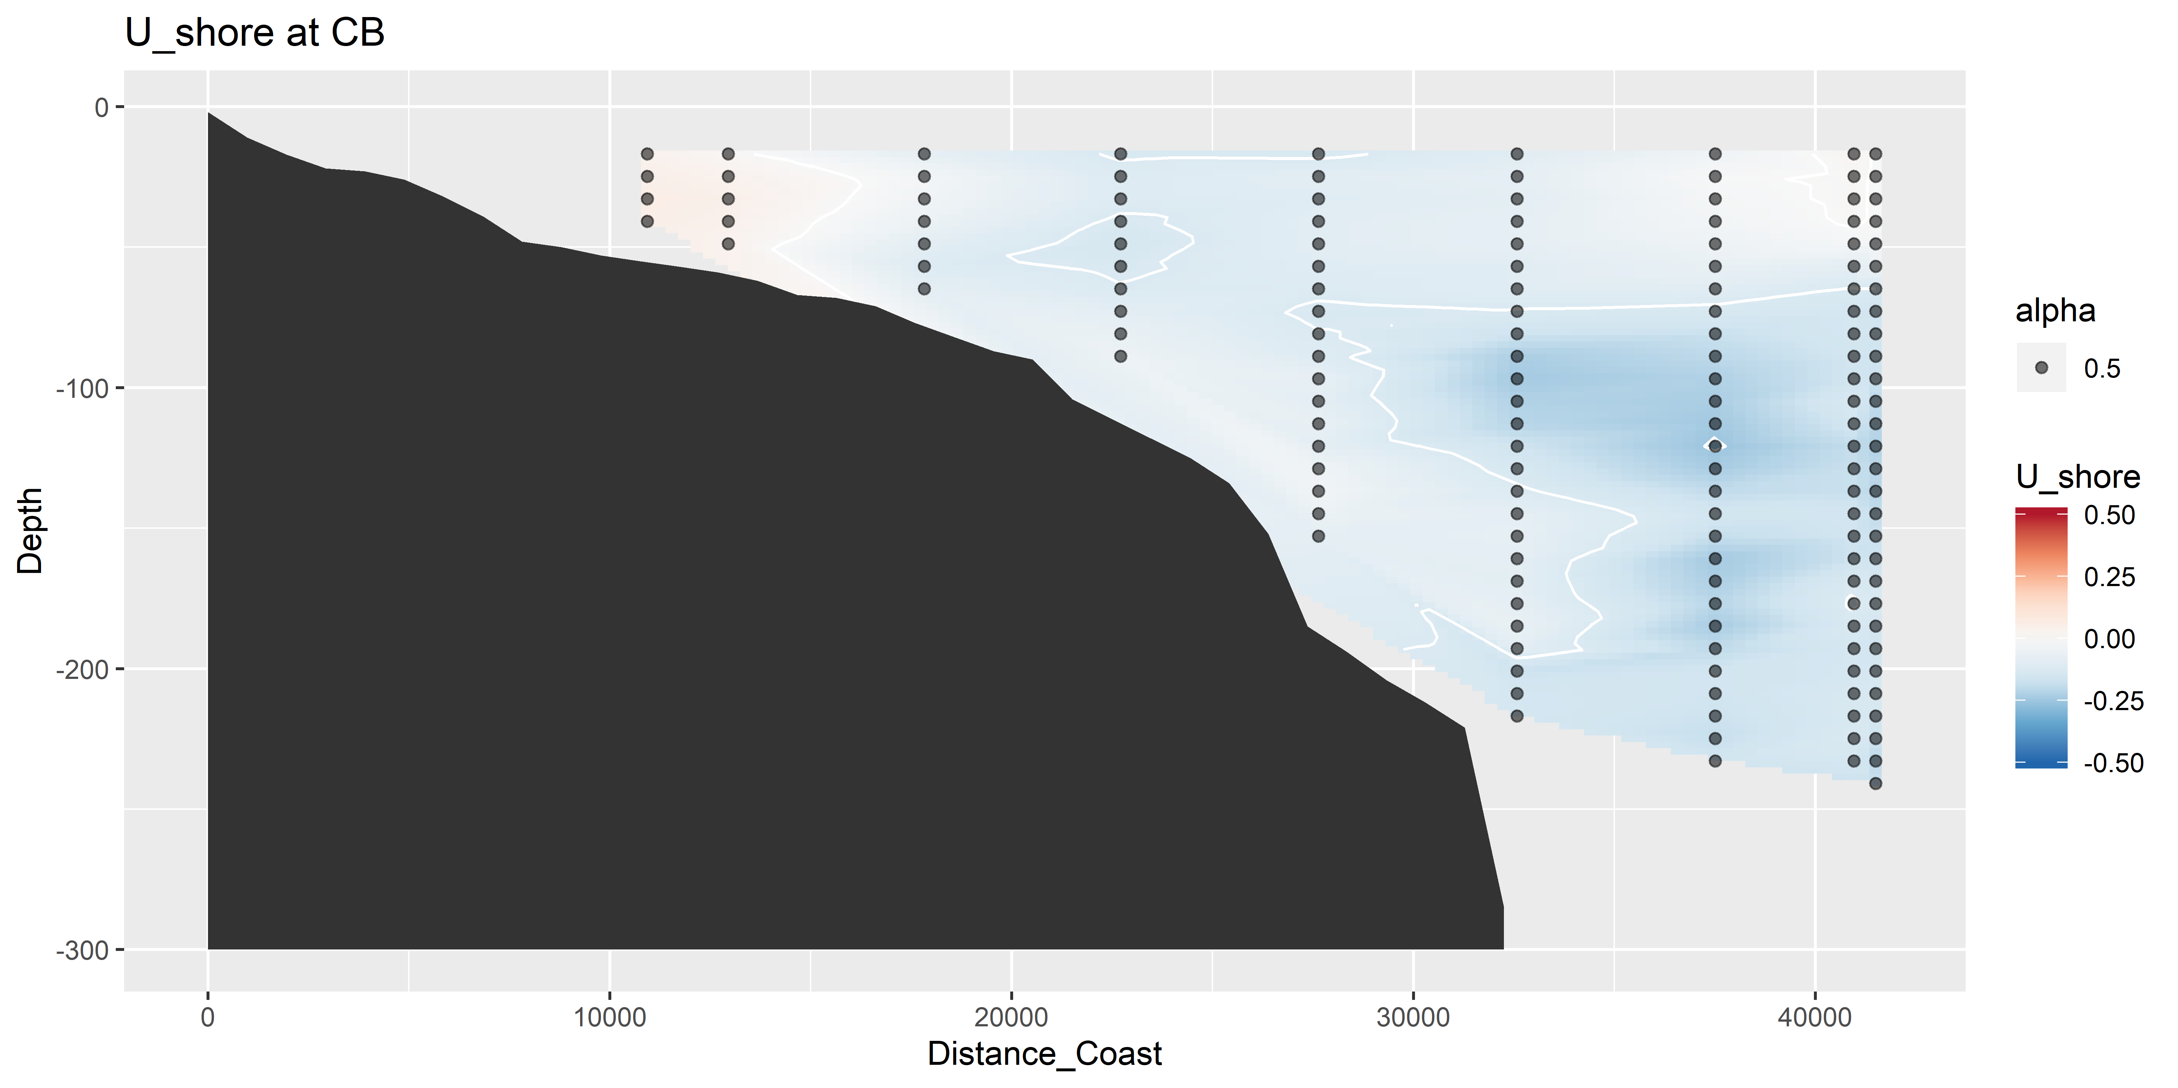
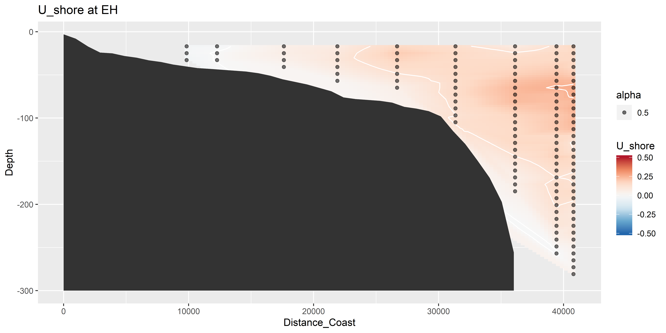
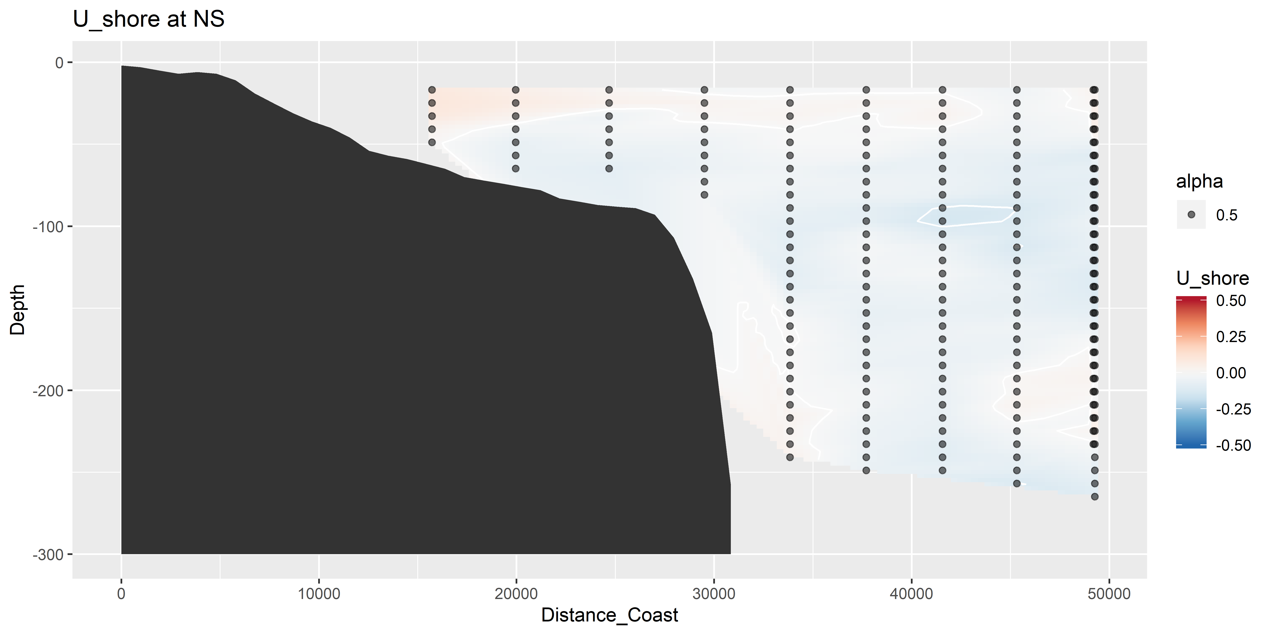
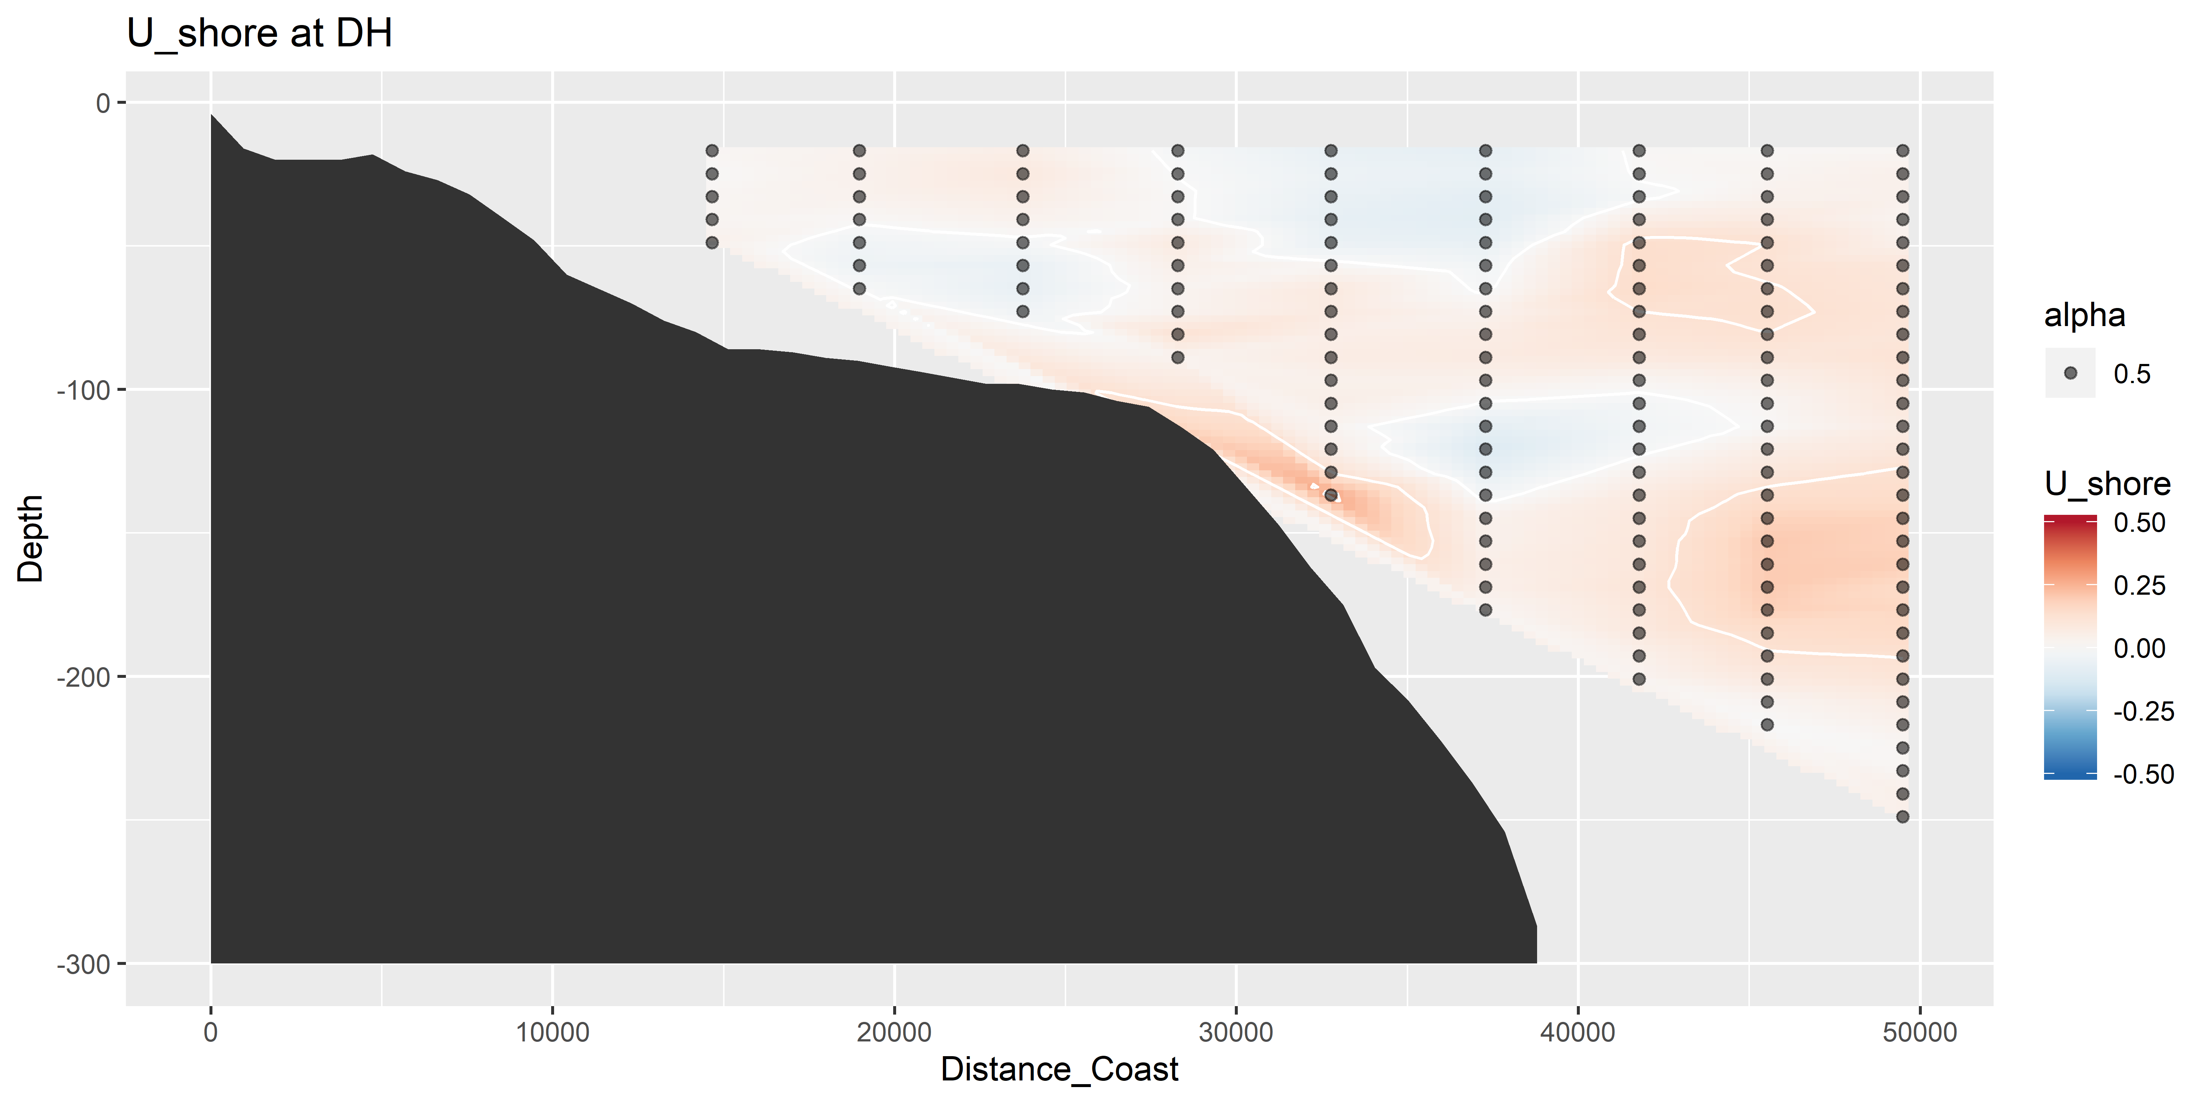
U vectors – shoreline rotated (m s⁻¹)

Slide 13
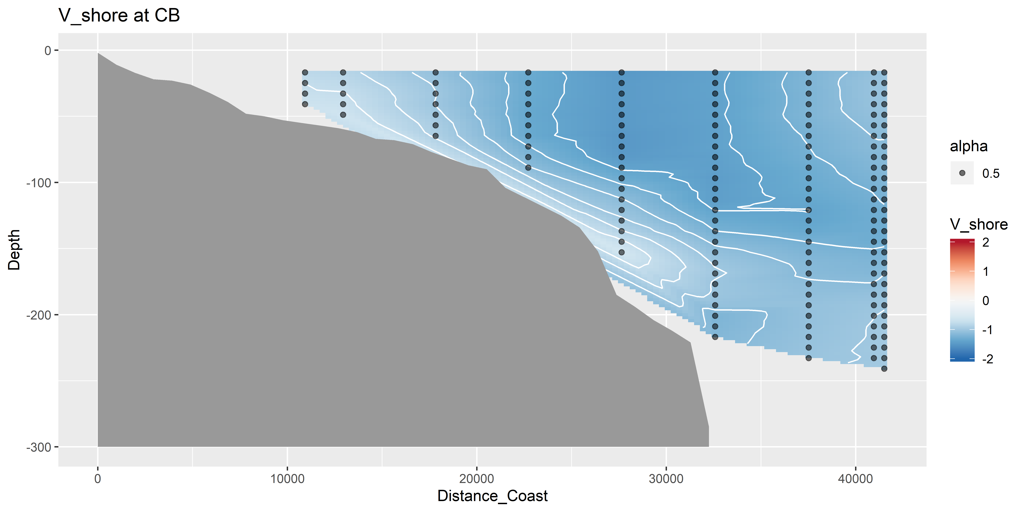
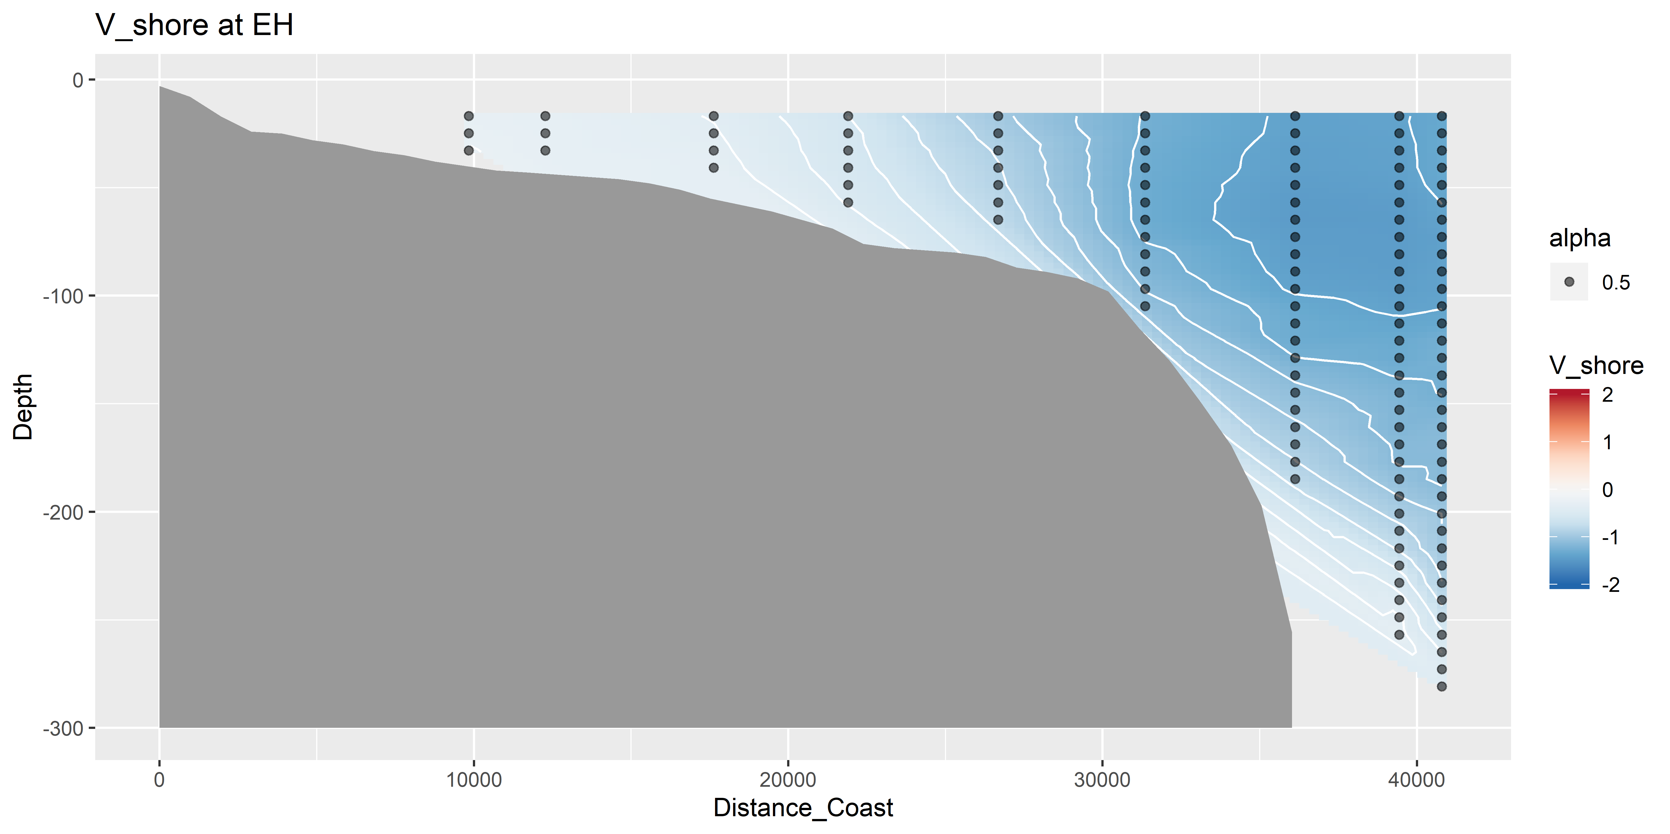
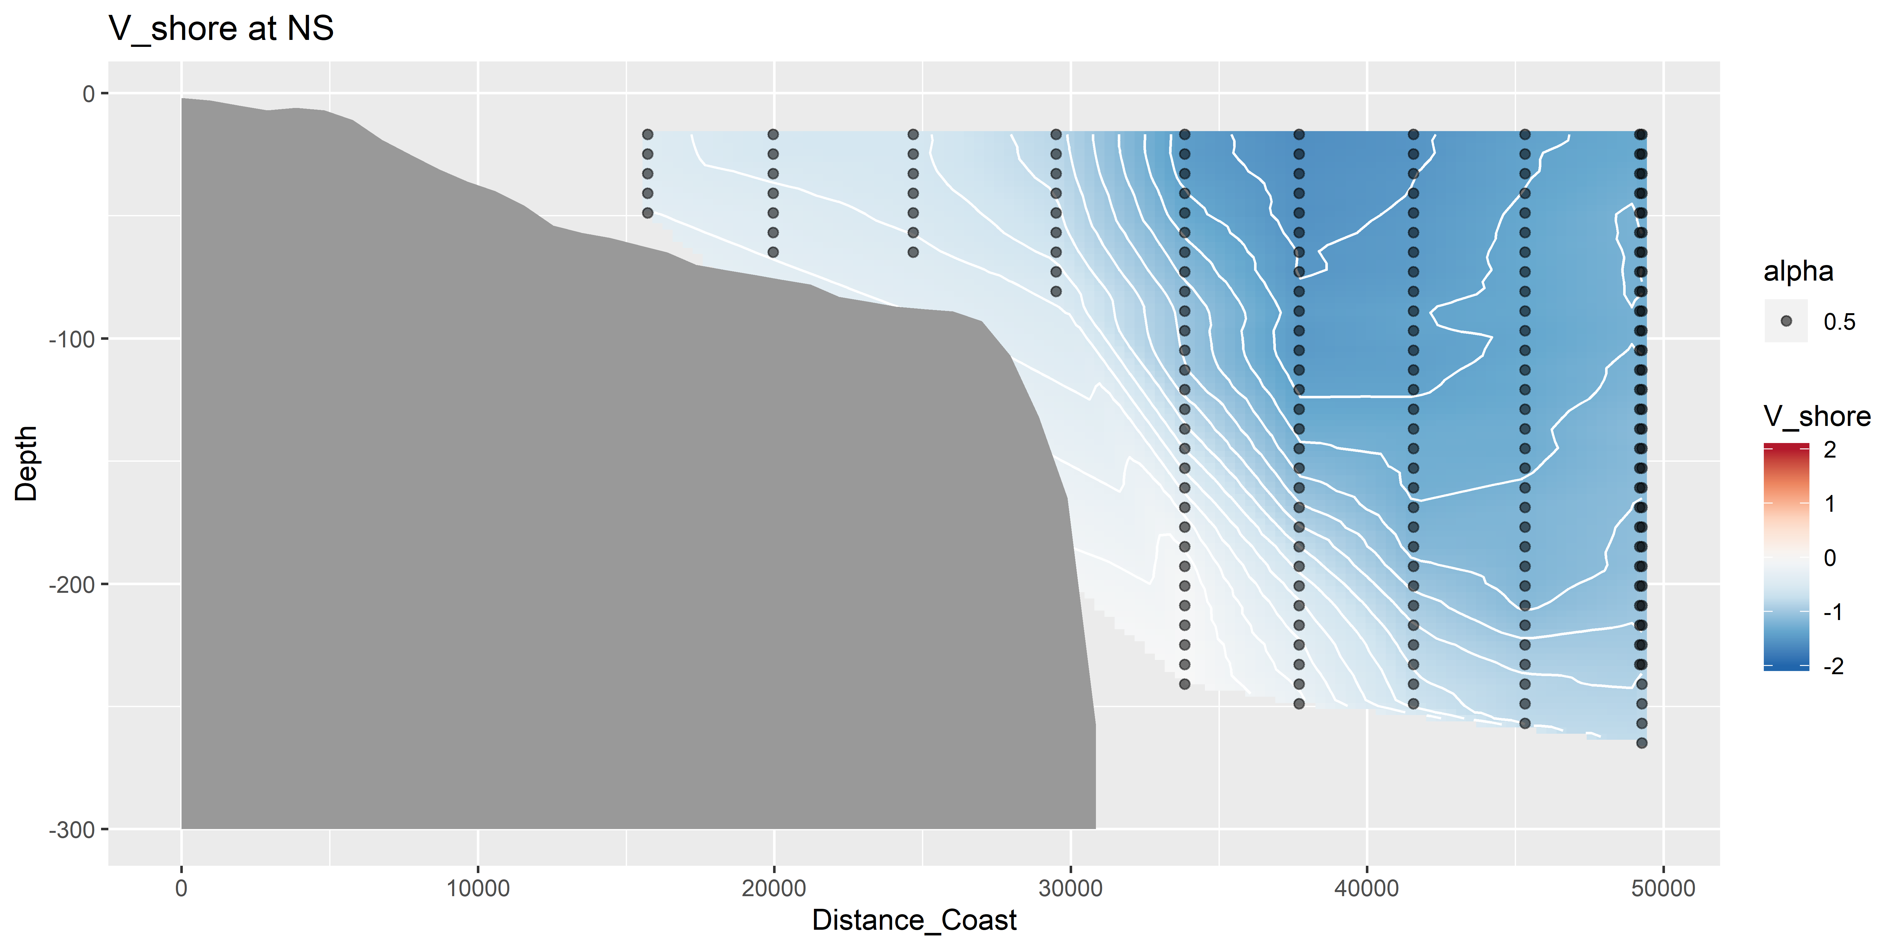
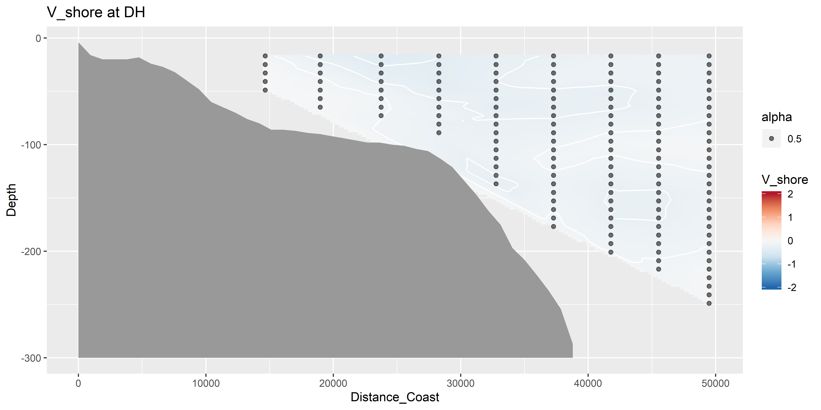
V vectors – shoreline rotated (m s⁻¹)

Slide 14
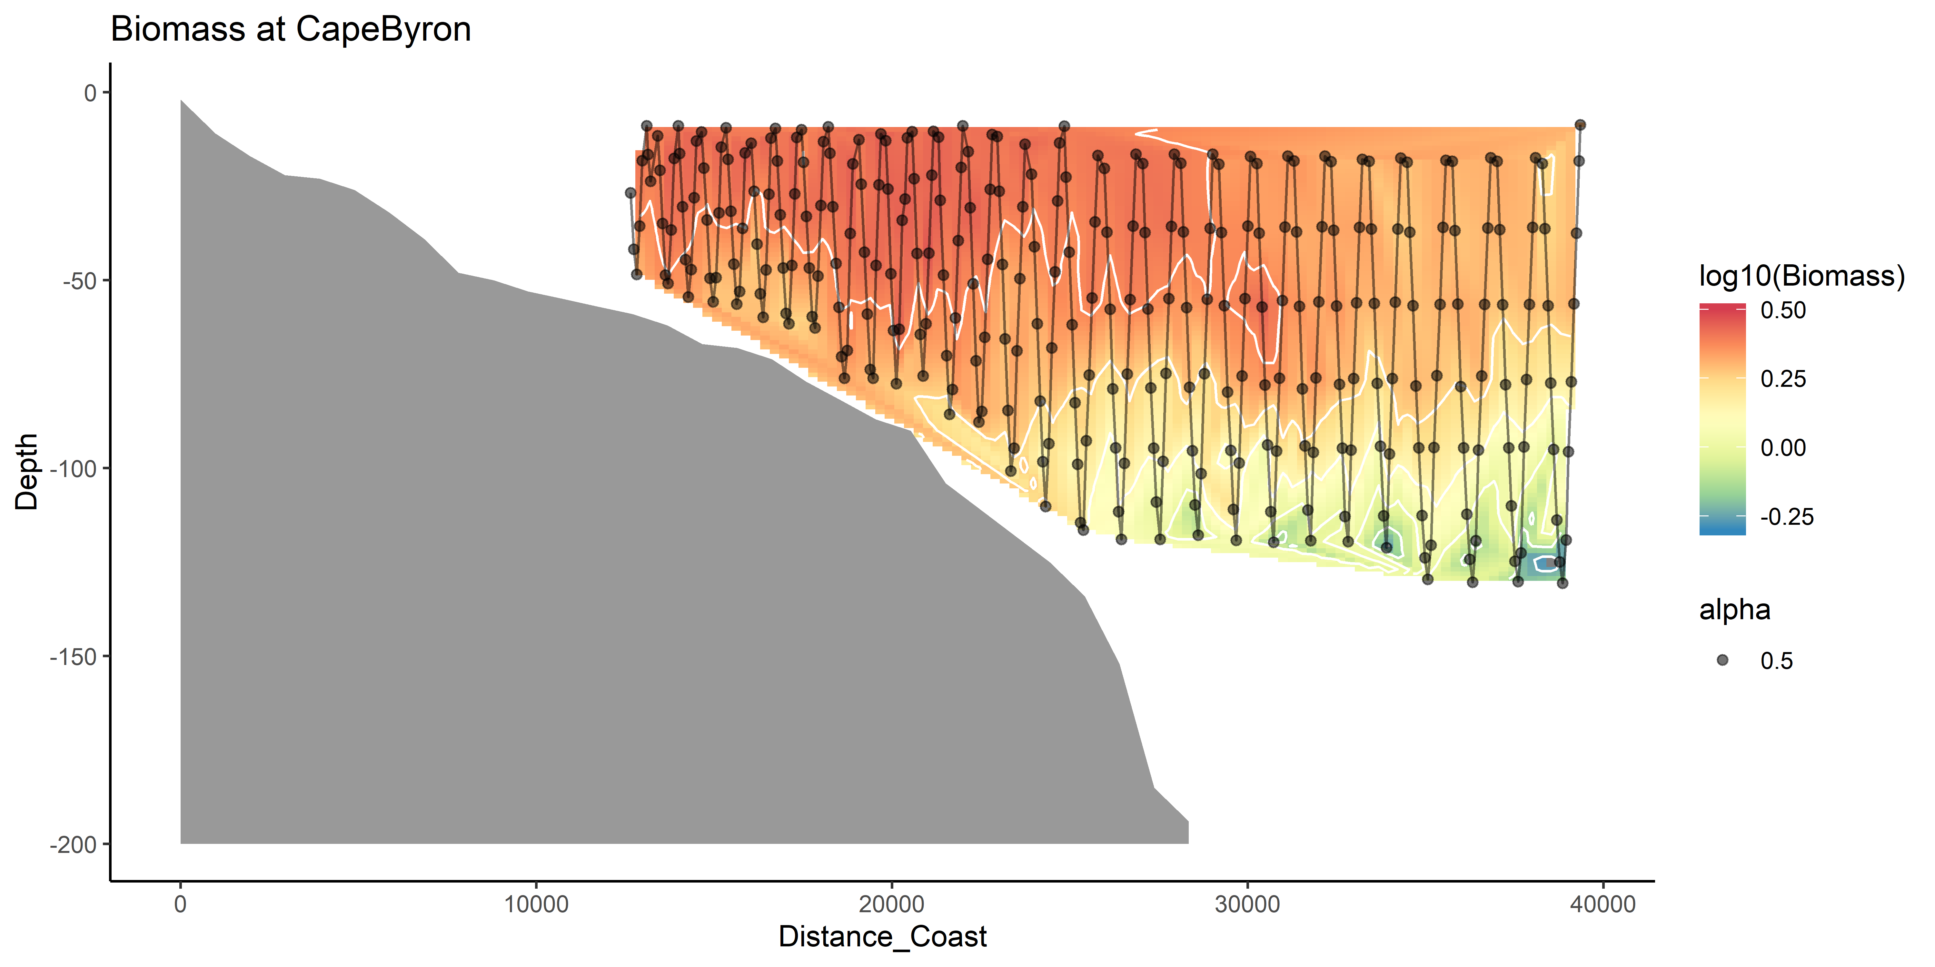
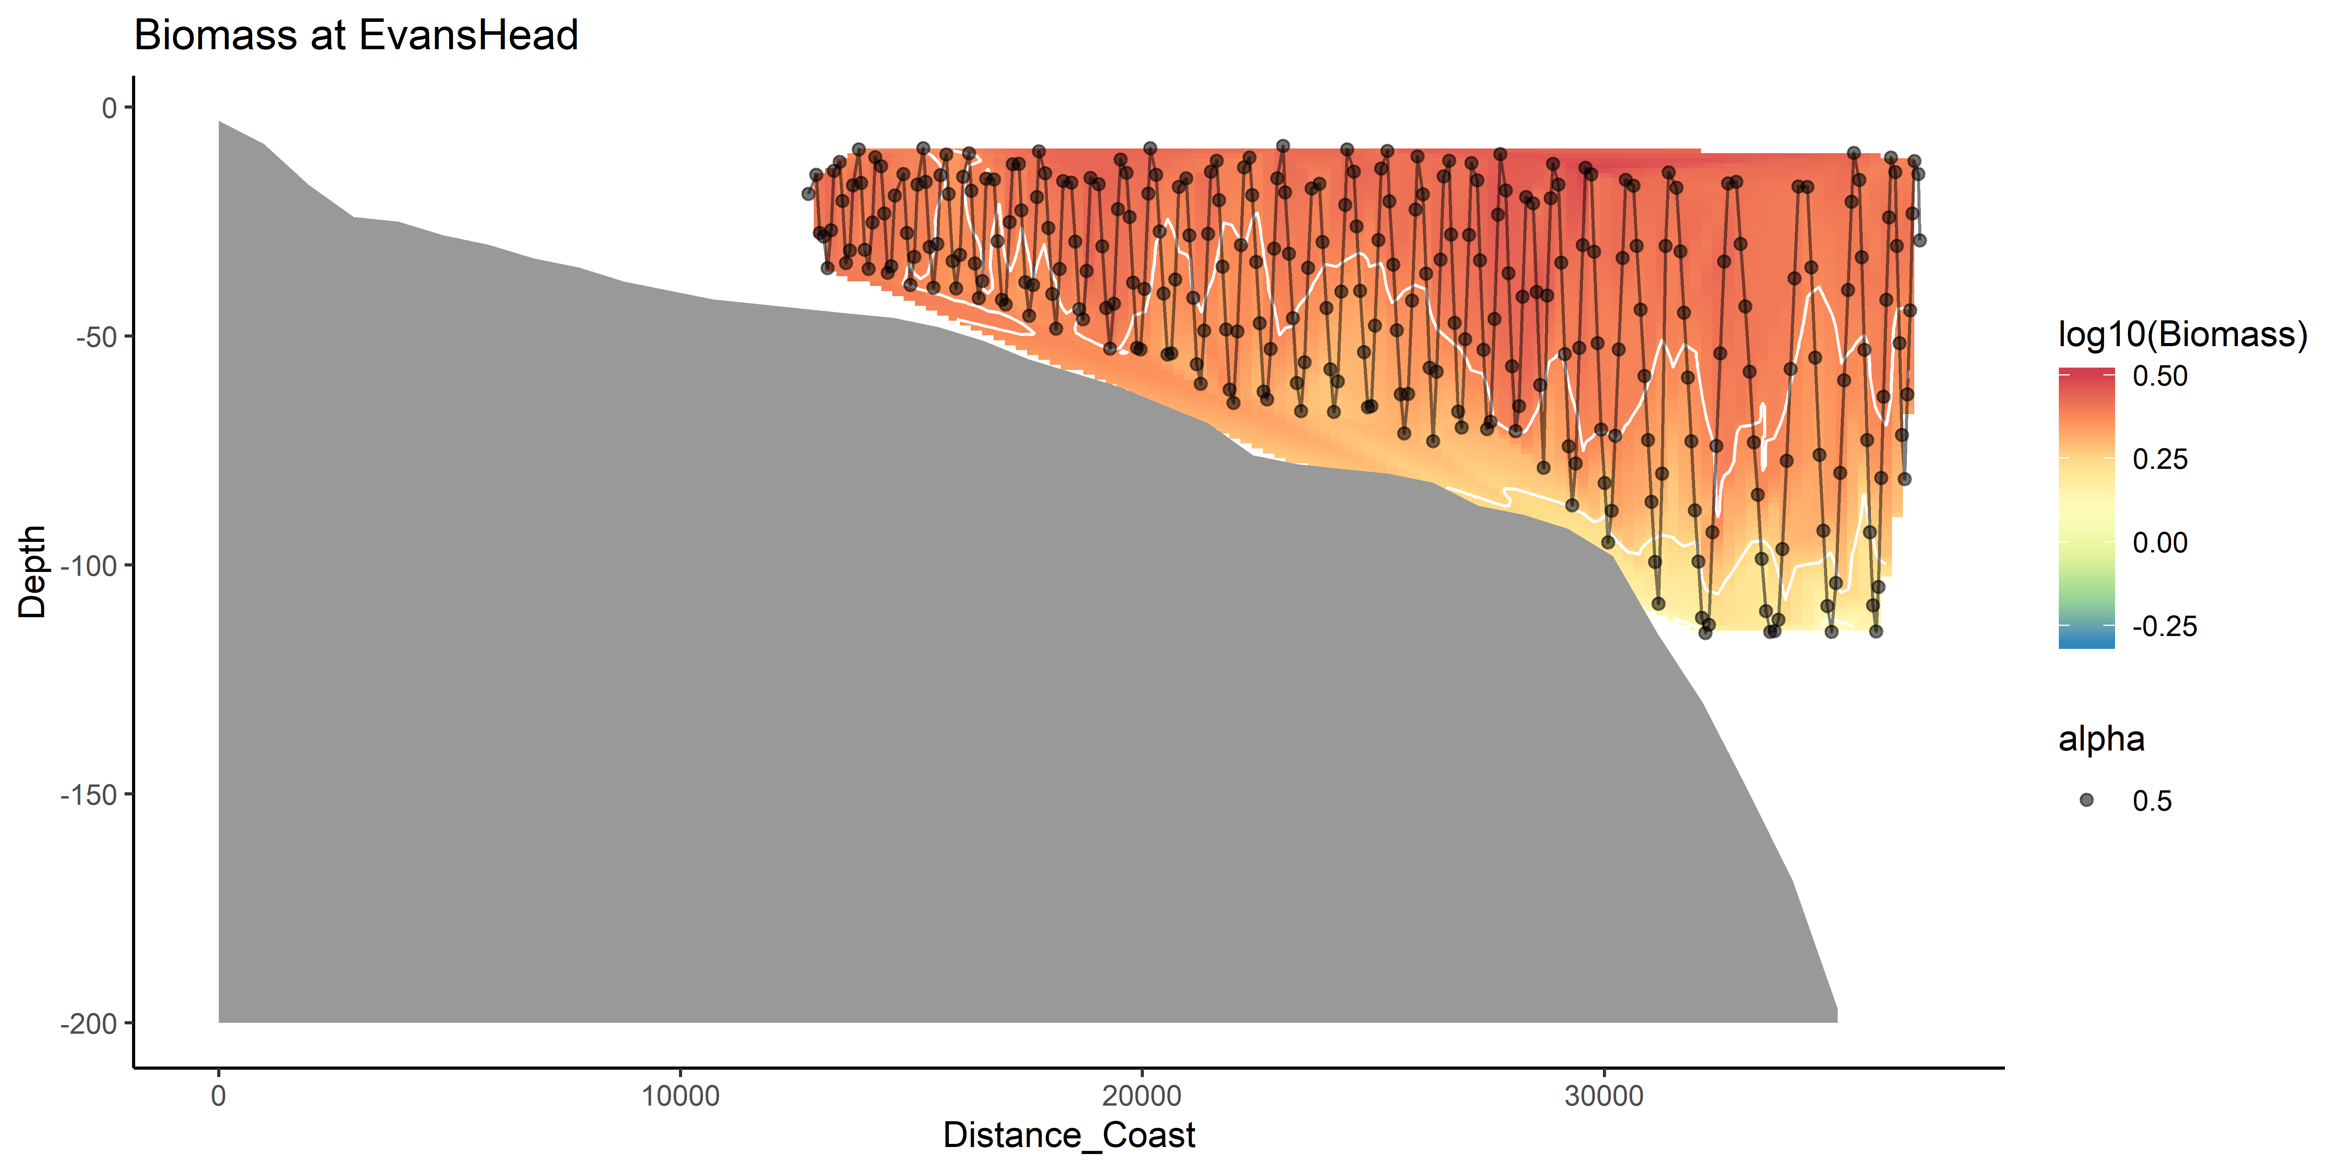
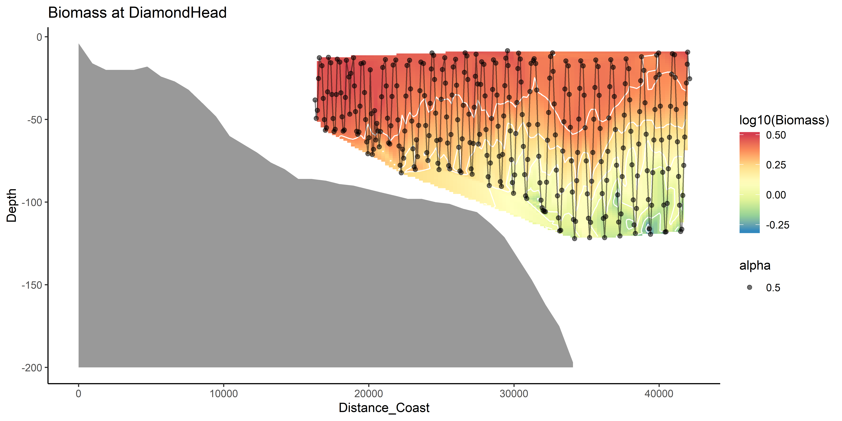
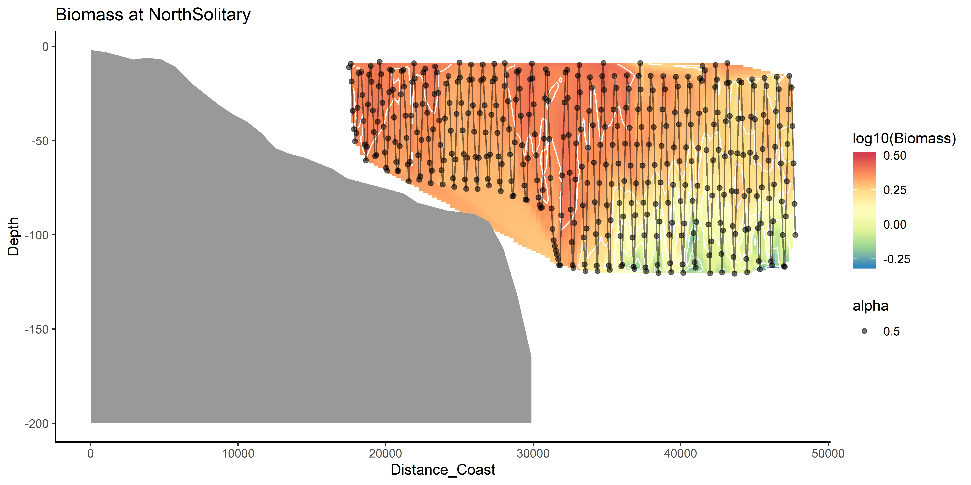
Zooplankton Biomass

Slide 15
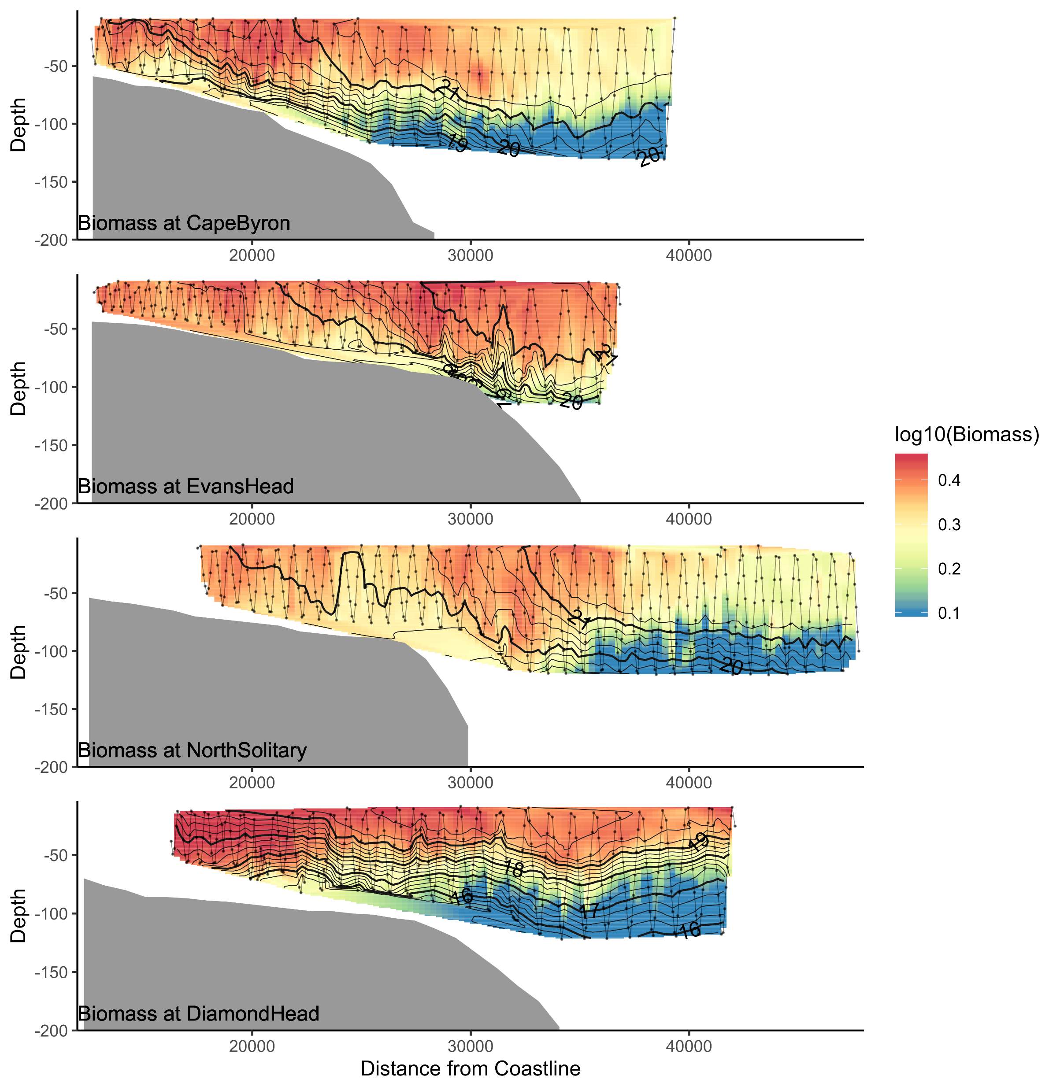
Biomass

Slide 16
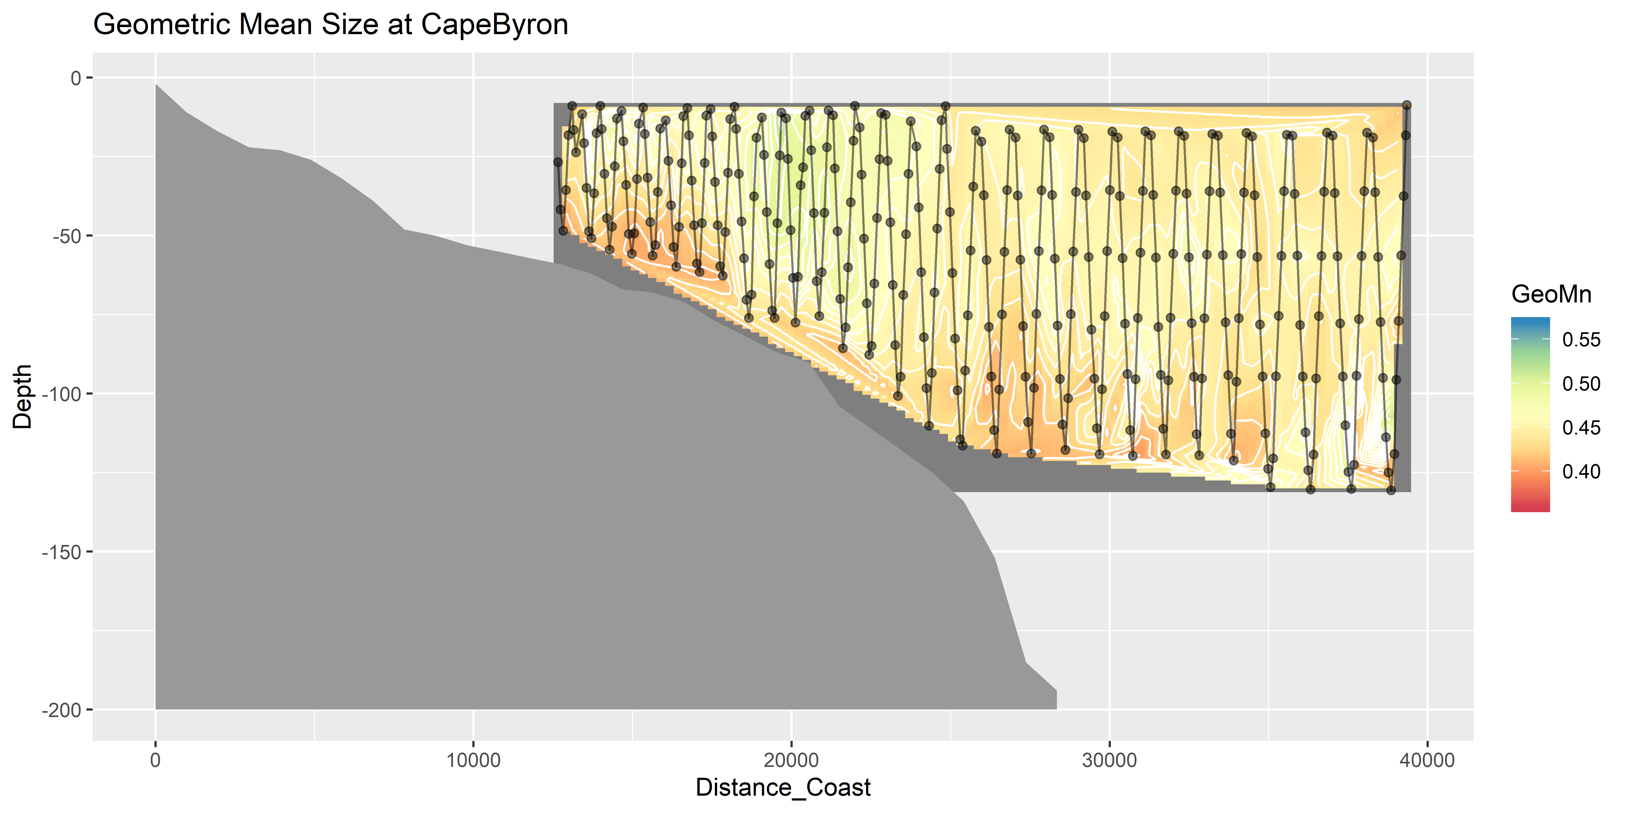
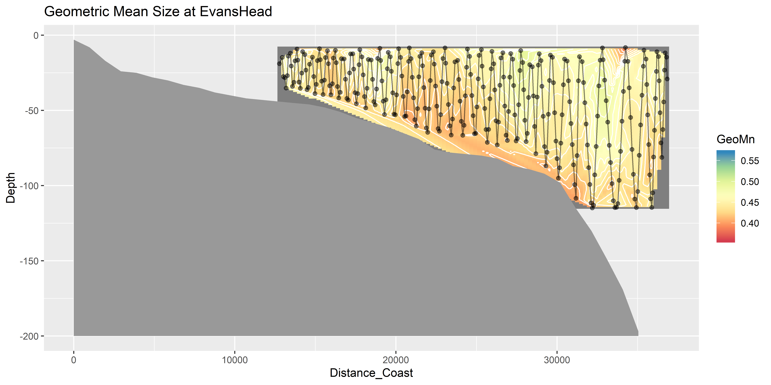
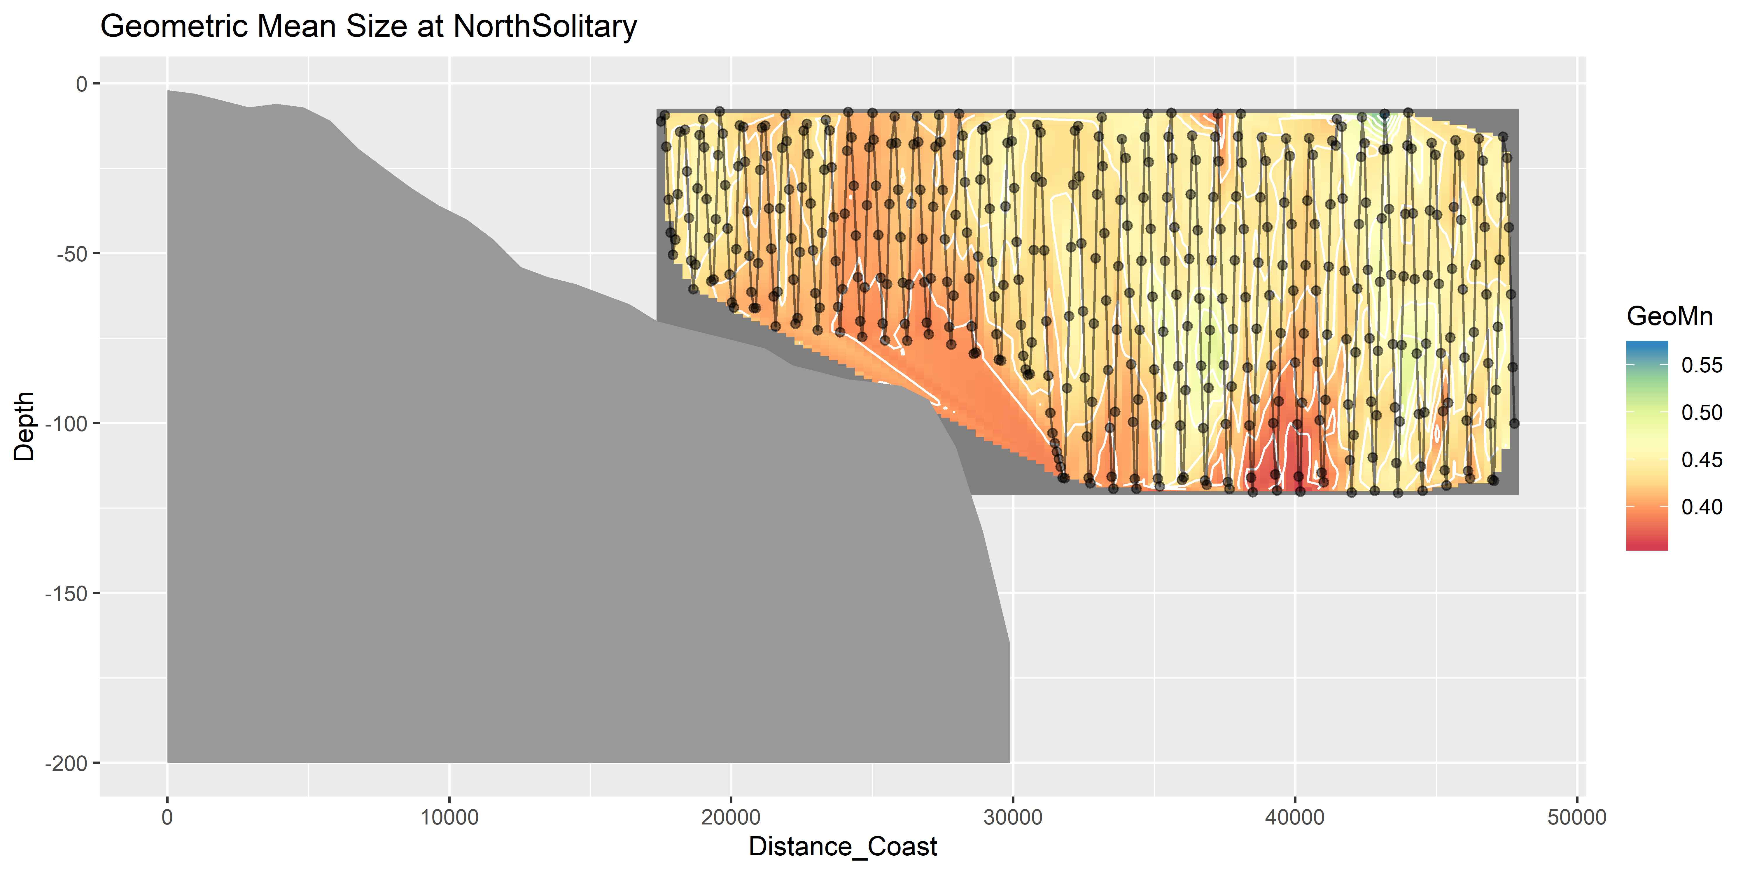
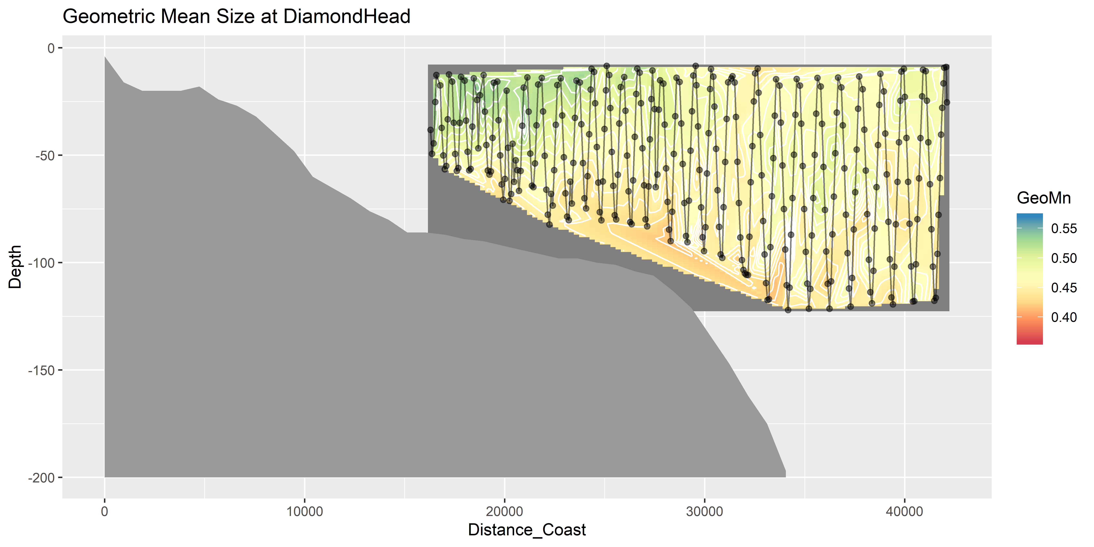
Geometric Mean Size

Slide 17
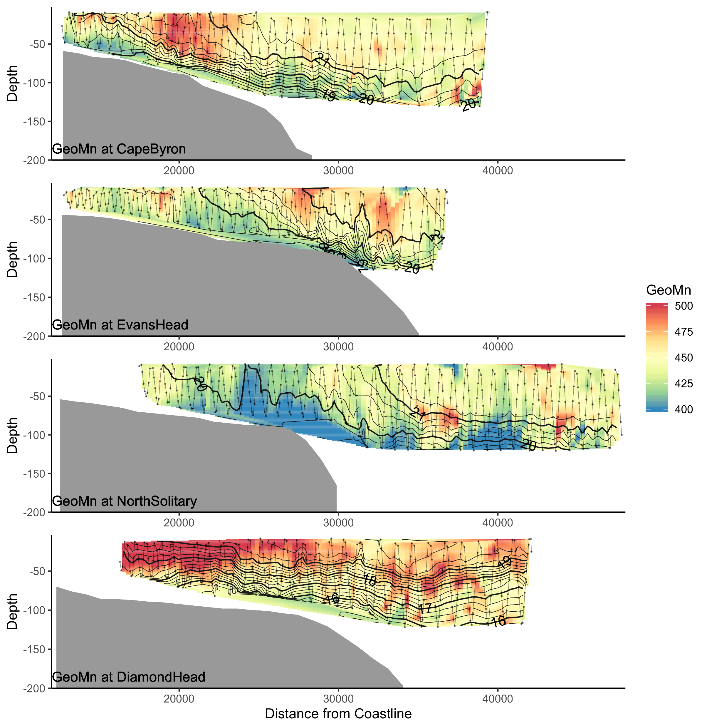
Geo Mean Size

Slide 18
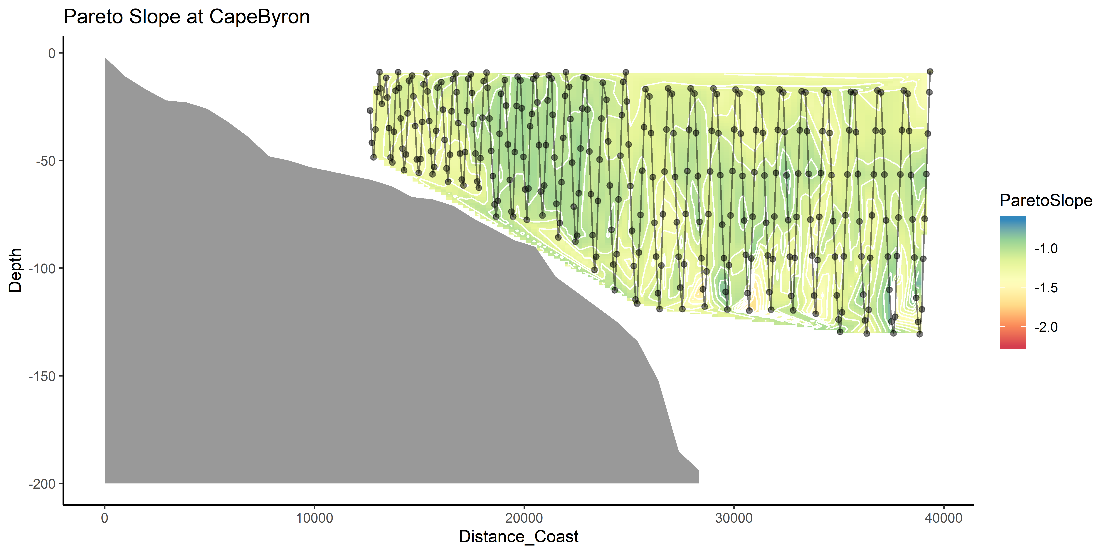
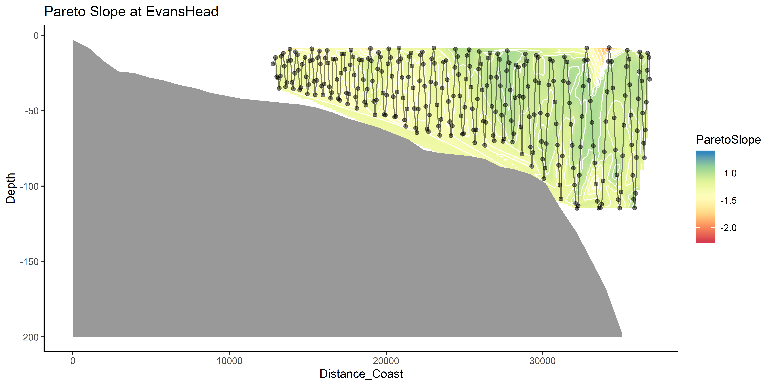
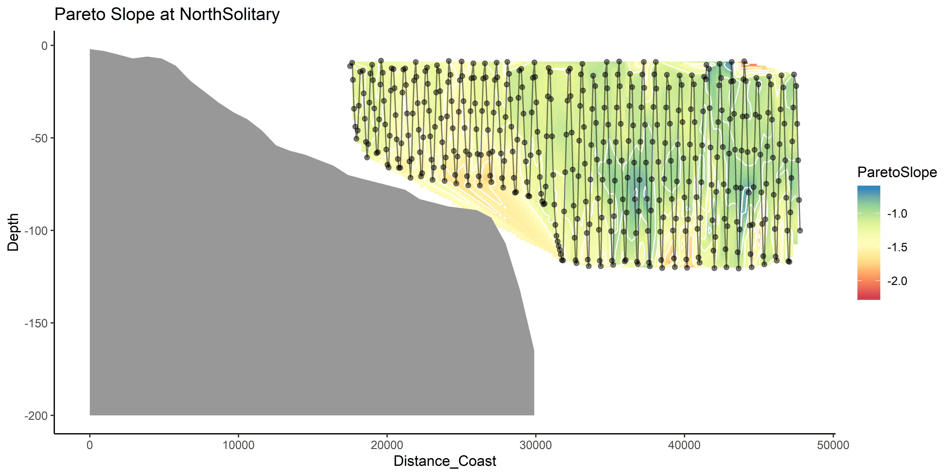
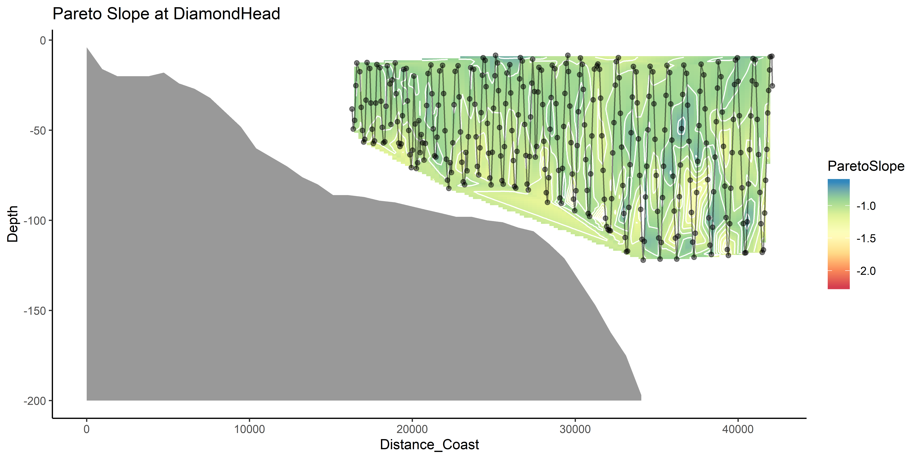
Pareto Slope

Slide 19
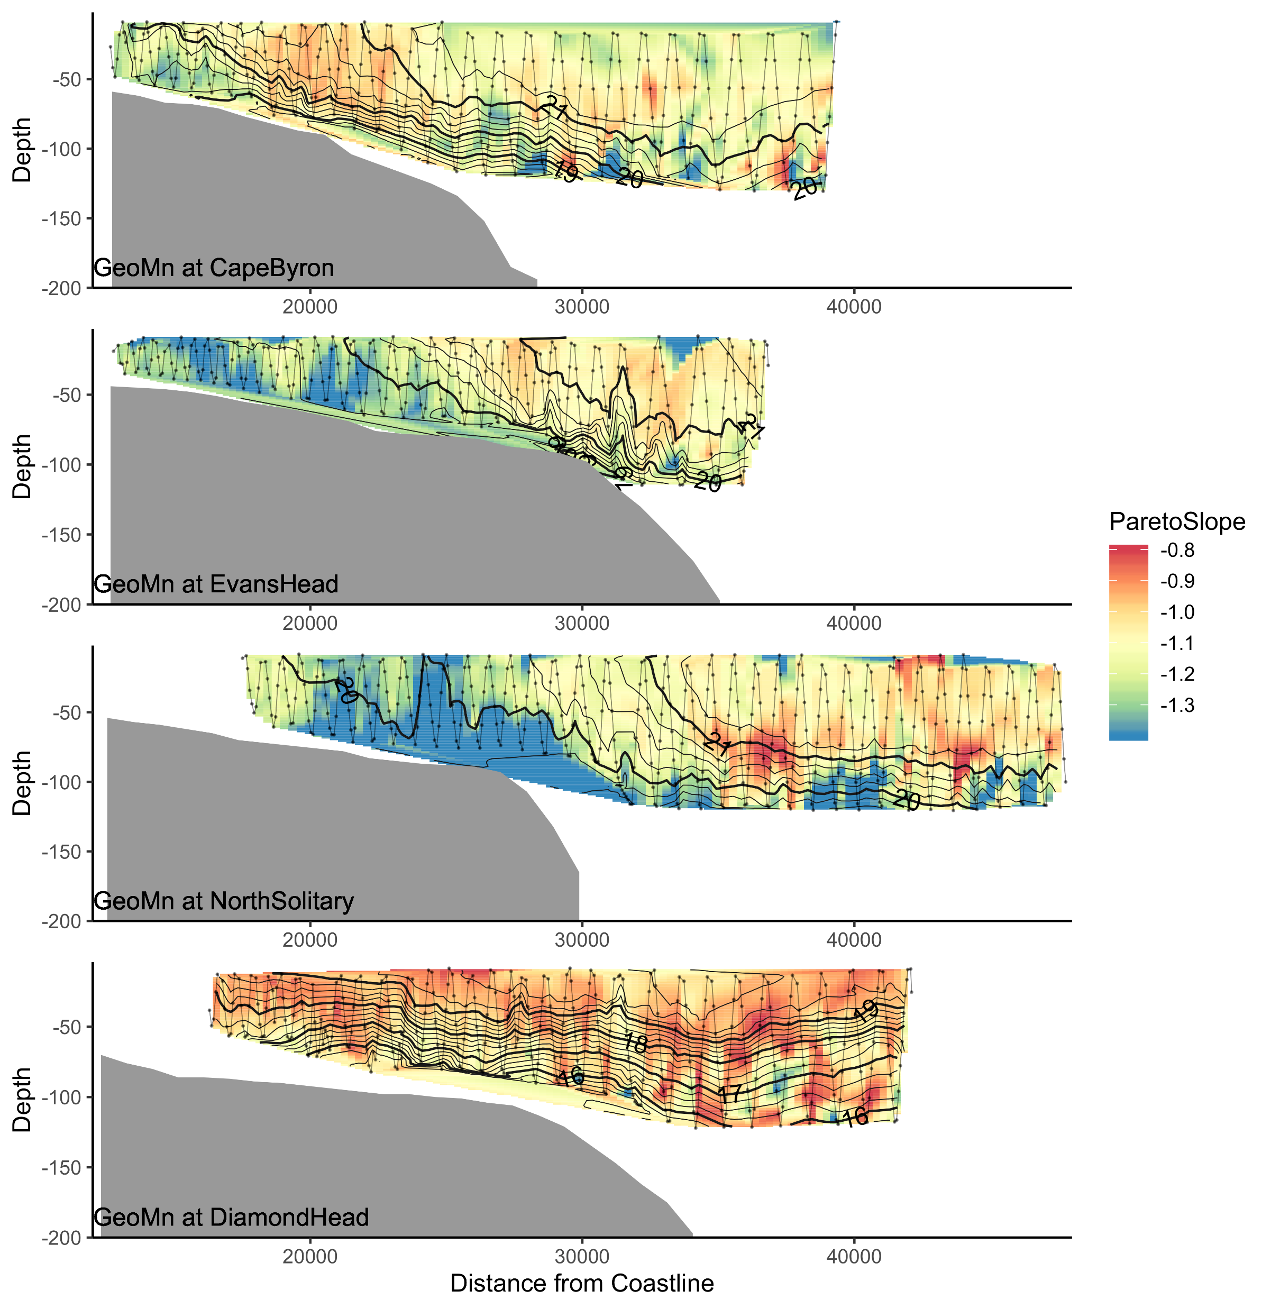
Pareto Slope

Slide 20
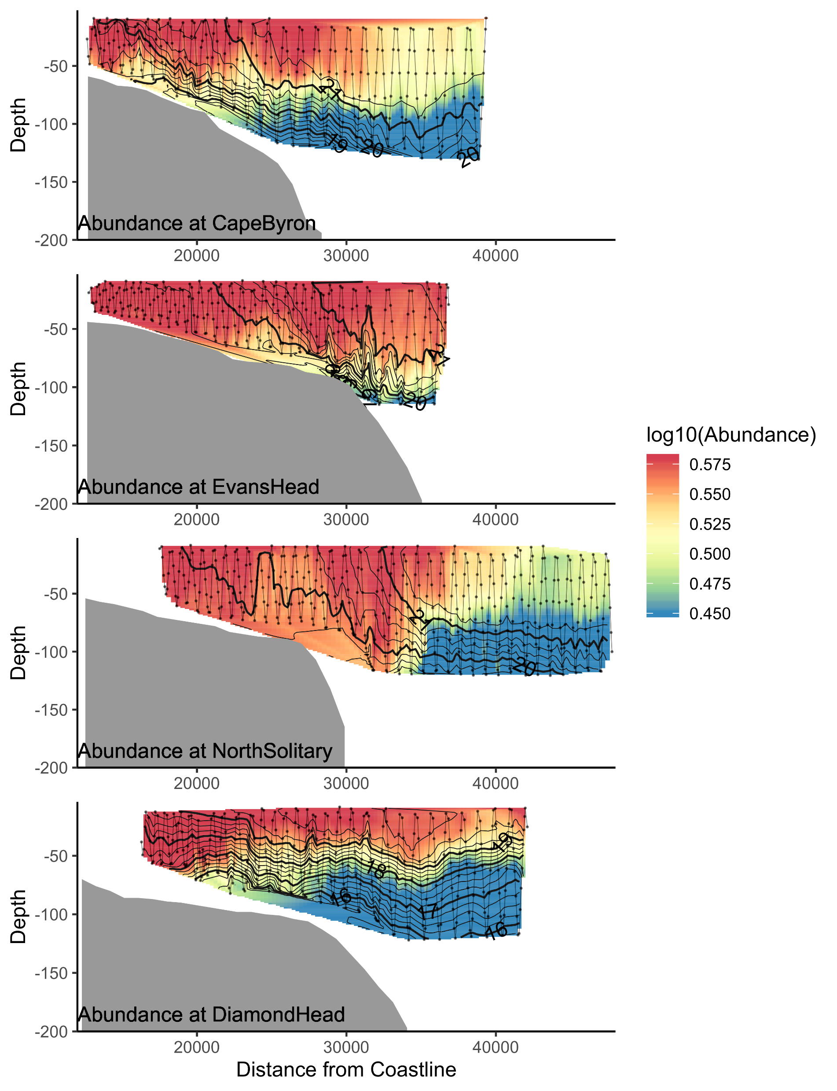
Abundance

Slide 21
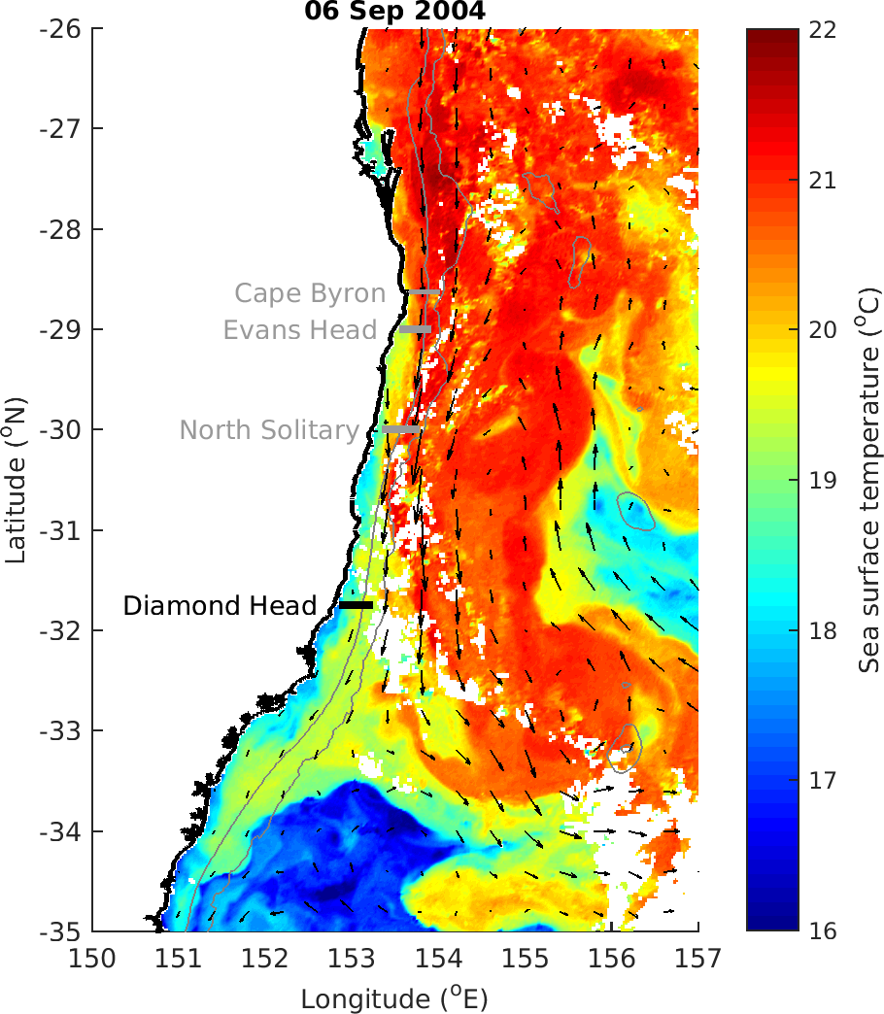

Slide 22
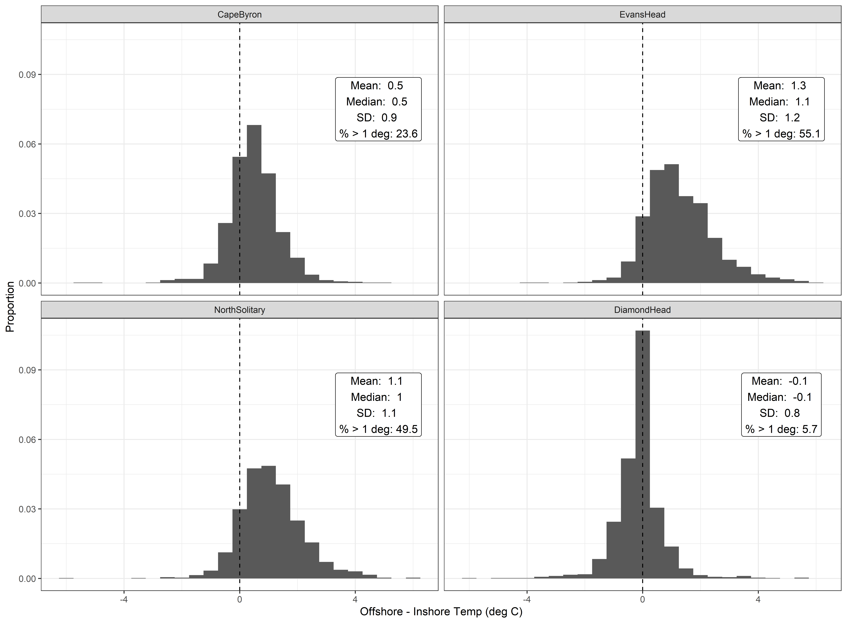

Slide 23
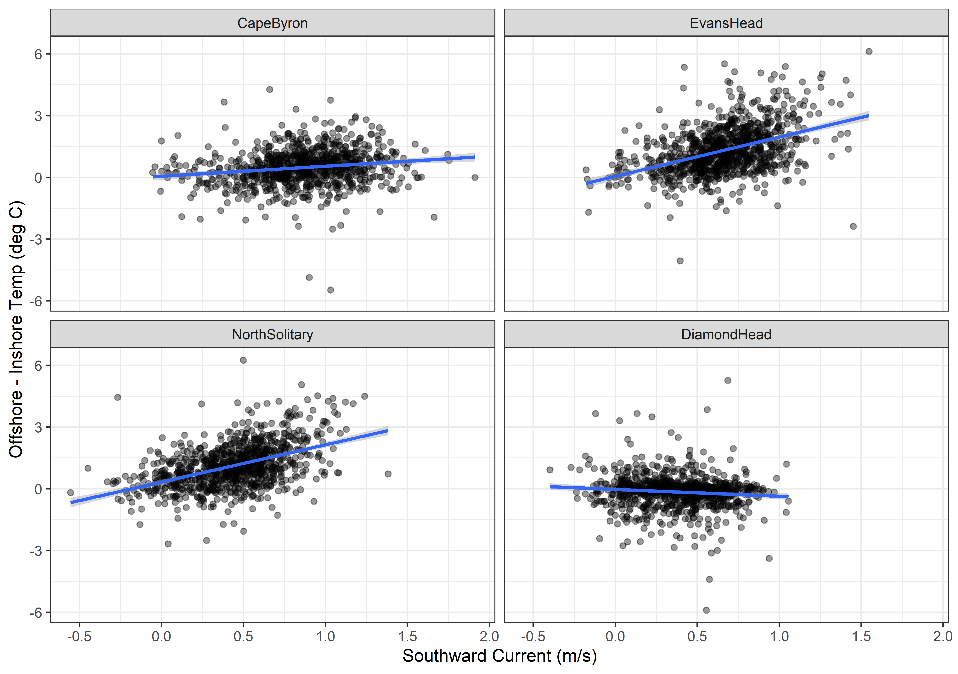

Slide 24
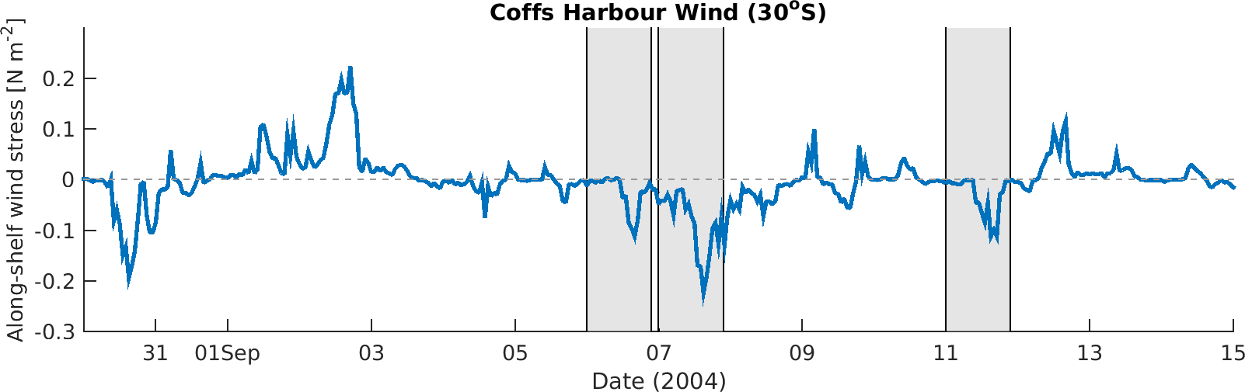
Wind Stress
DH
EH
CB

Slide 25
Zooplankton Characteristics
Biomass decreases with depth and distance from shore
Does size vary between the EAC water masses and separation zone?
Largest particles near shore at Diamond Head, due to separation and different water?
Slope does not appear to consistently approach -1 in offshore water (theoretical expectation)
Vandromme showed shallower slope offshore (-1 → -0.4; SW France)

Slide 27
OLDER STUFF

Slide 28
Linking water and zooplankton
Temp + Salt highly correlated (0.93)
Temp + Depth slight neg. cor. (-0.3)
Temp + Distance_Coast slight pos. cor (0.24)
Longitude + Distance_Coast slight pos. cor (0.09)
Moran’s I value = 0.33 (Biomass)
Moran’s I value = 0.29 (Pareto Slope)

Slide 29
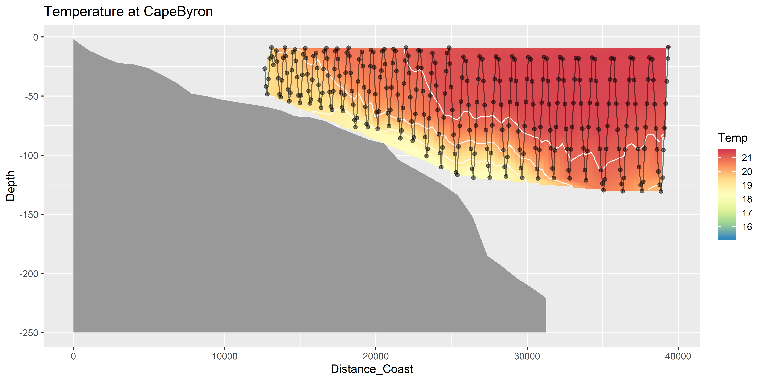
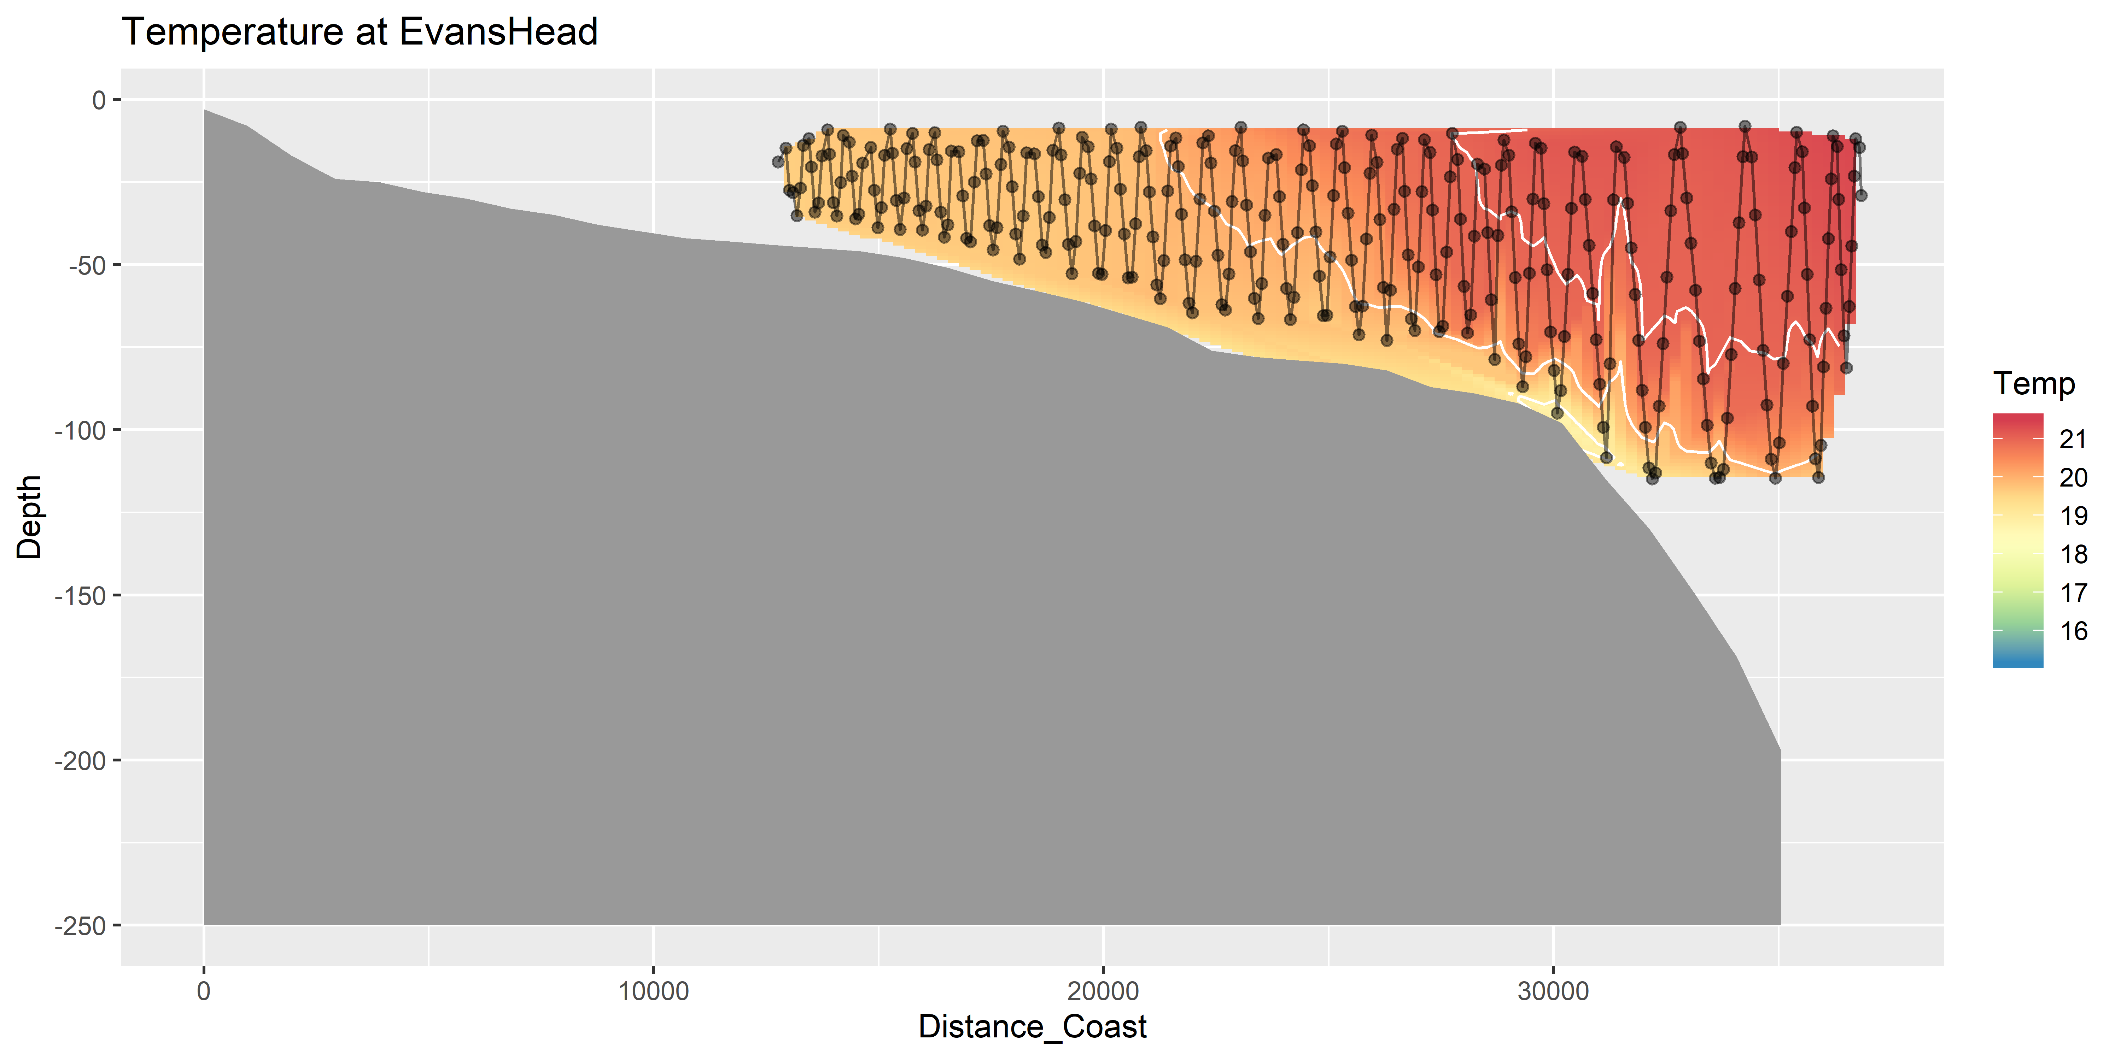
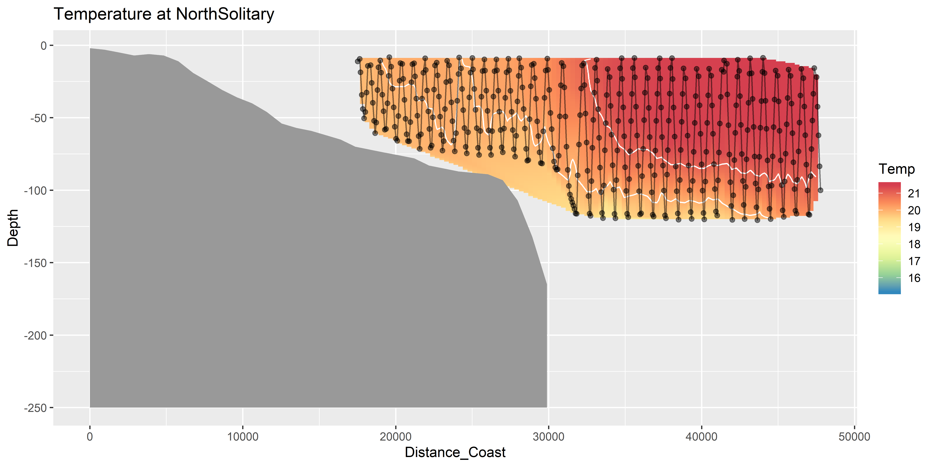
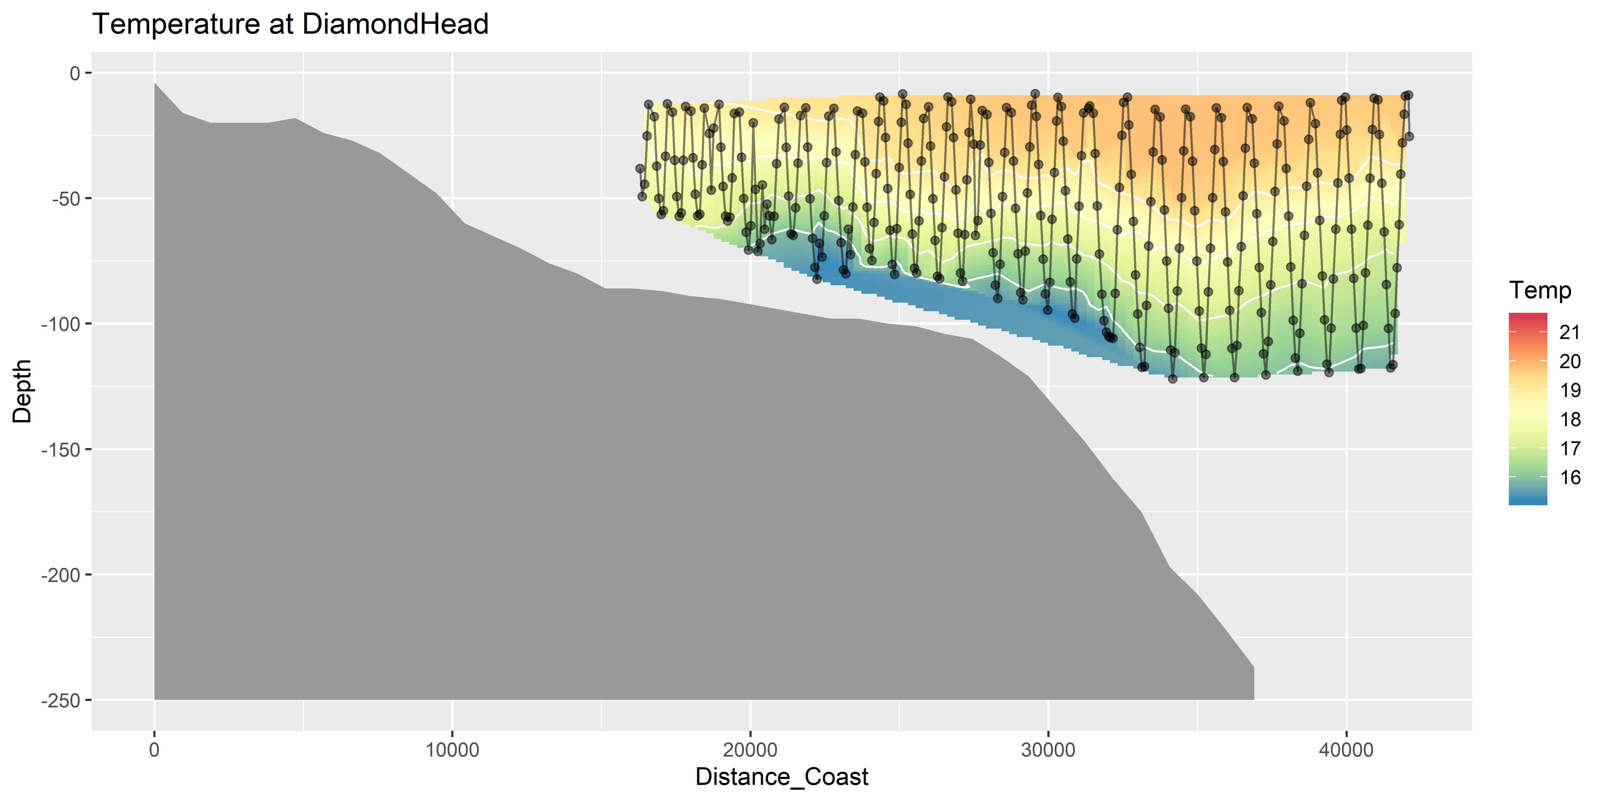
Temperature (seasoar)

Slide 30
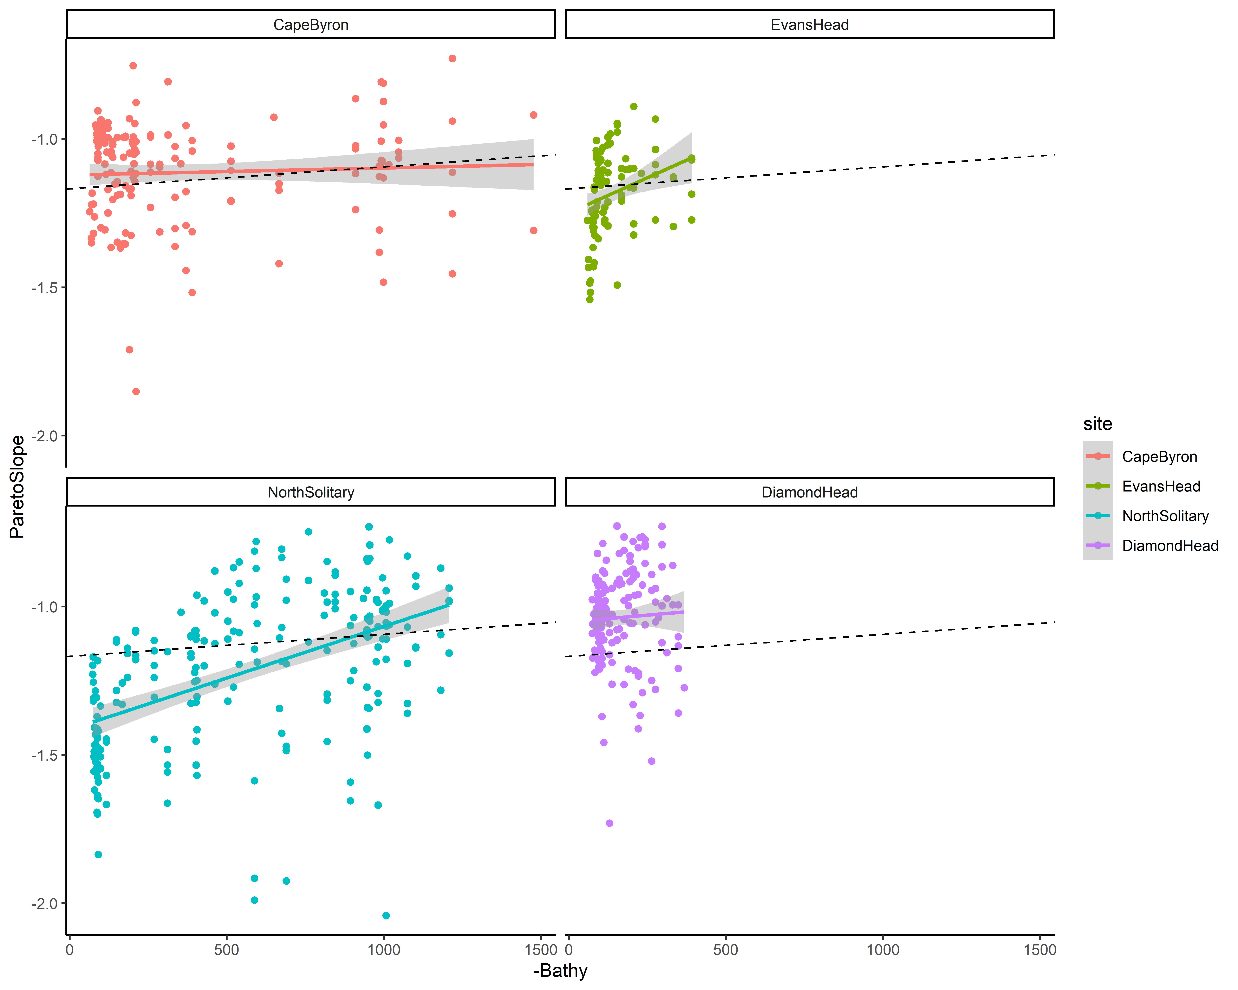
NBSS Pareto Slope
Dotted line is overall mean

Slide 31
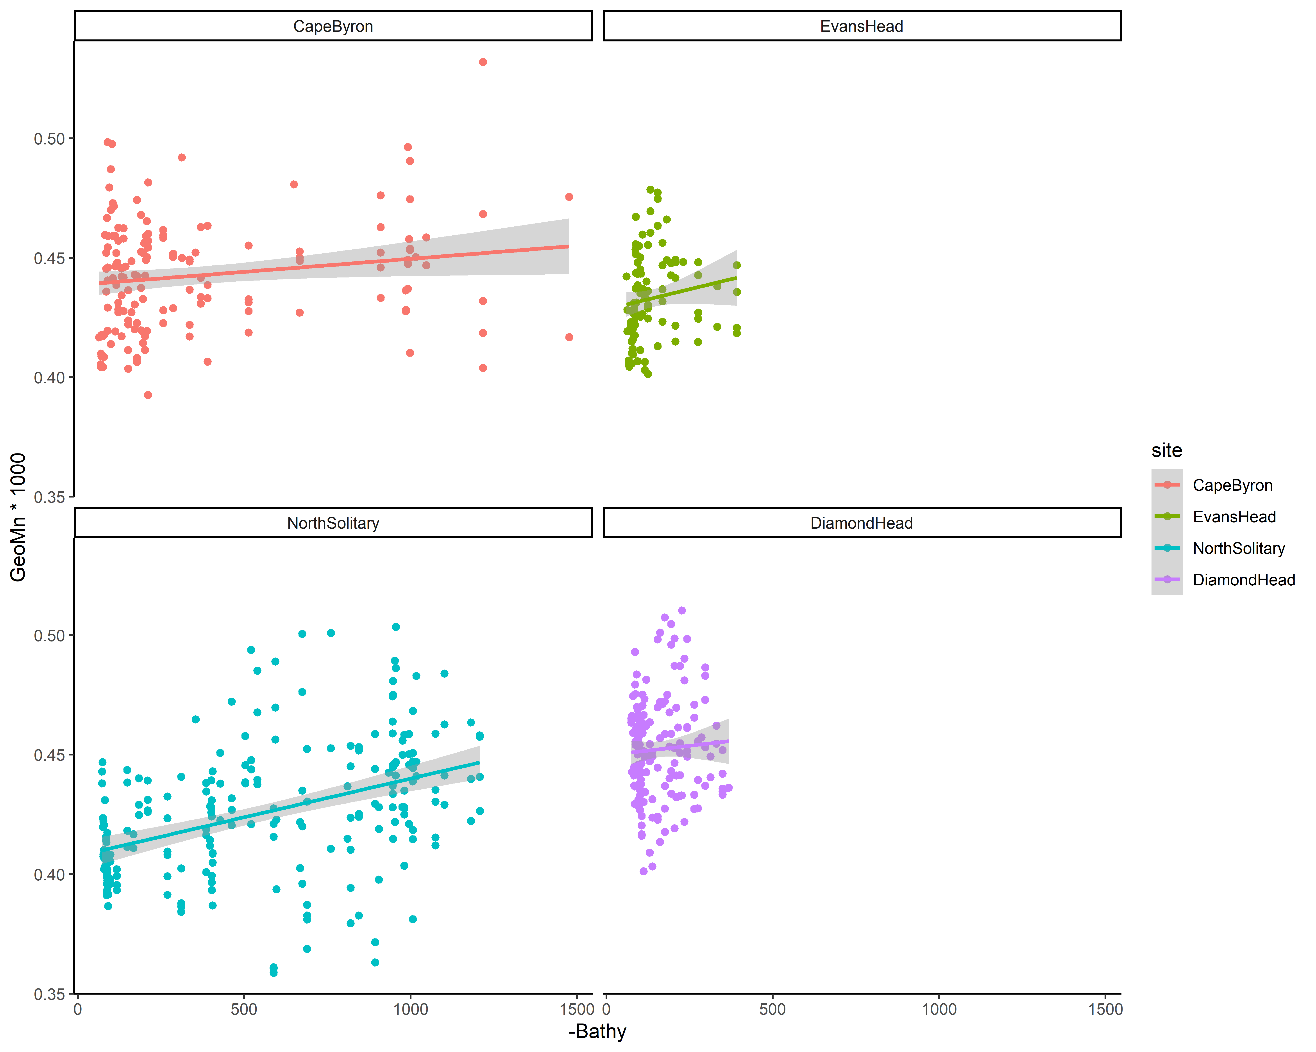
Size

Slide 32
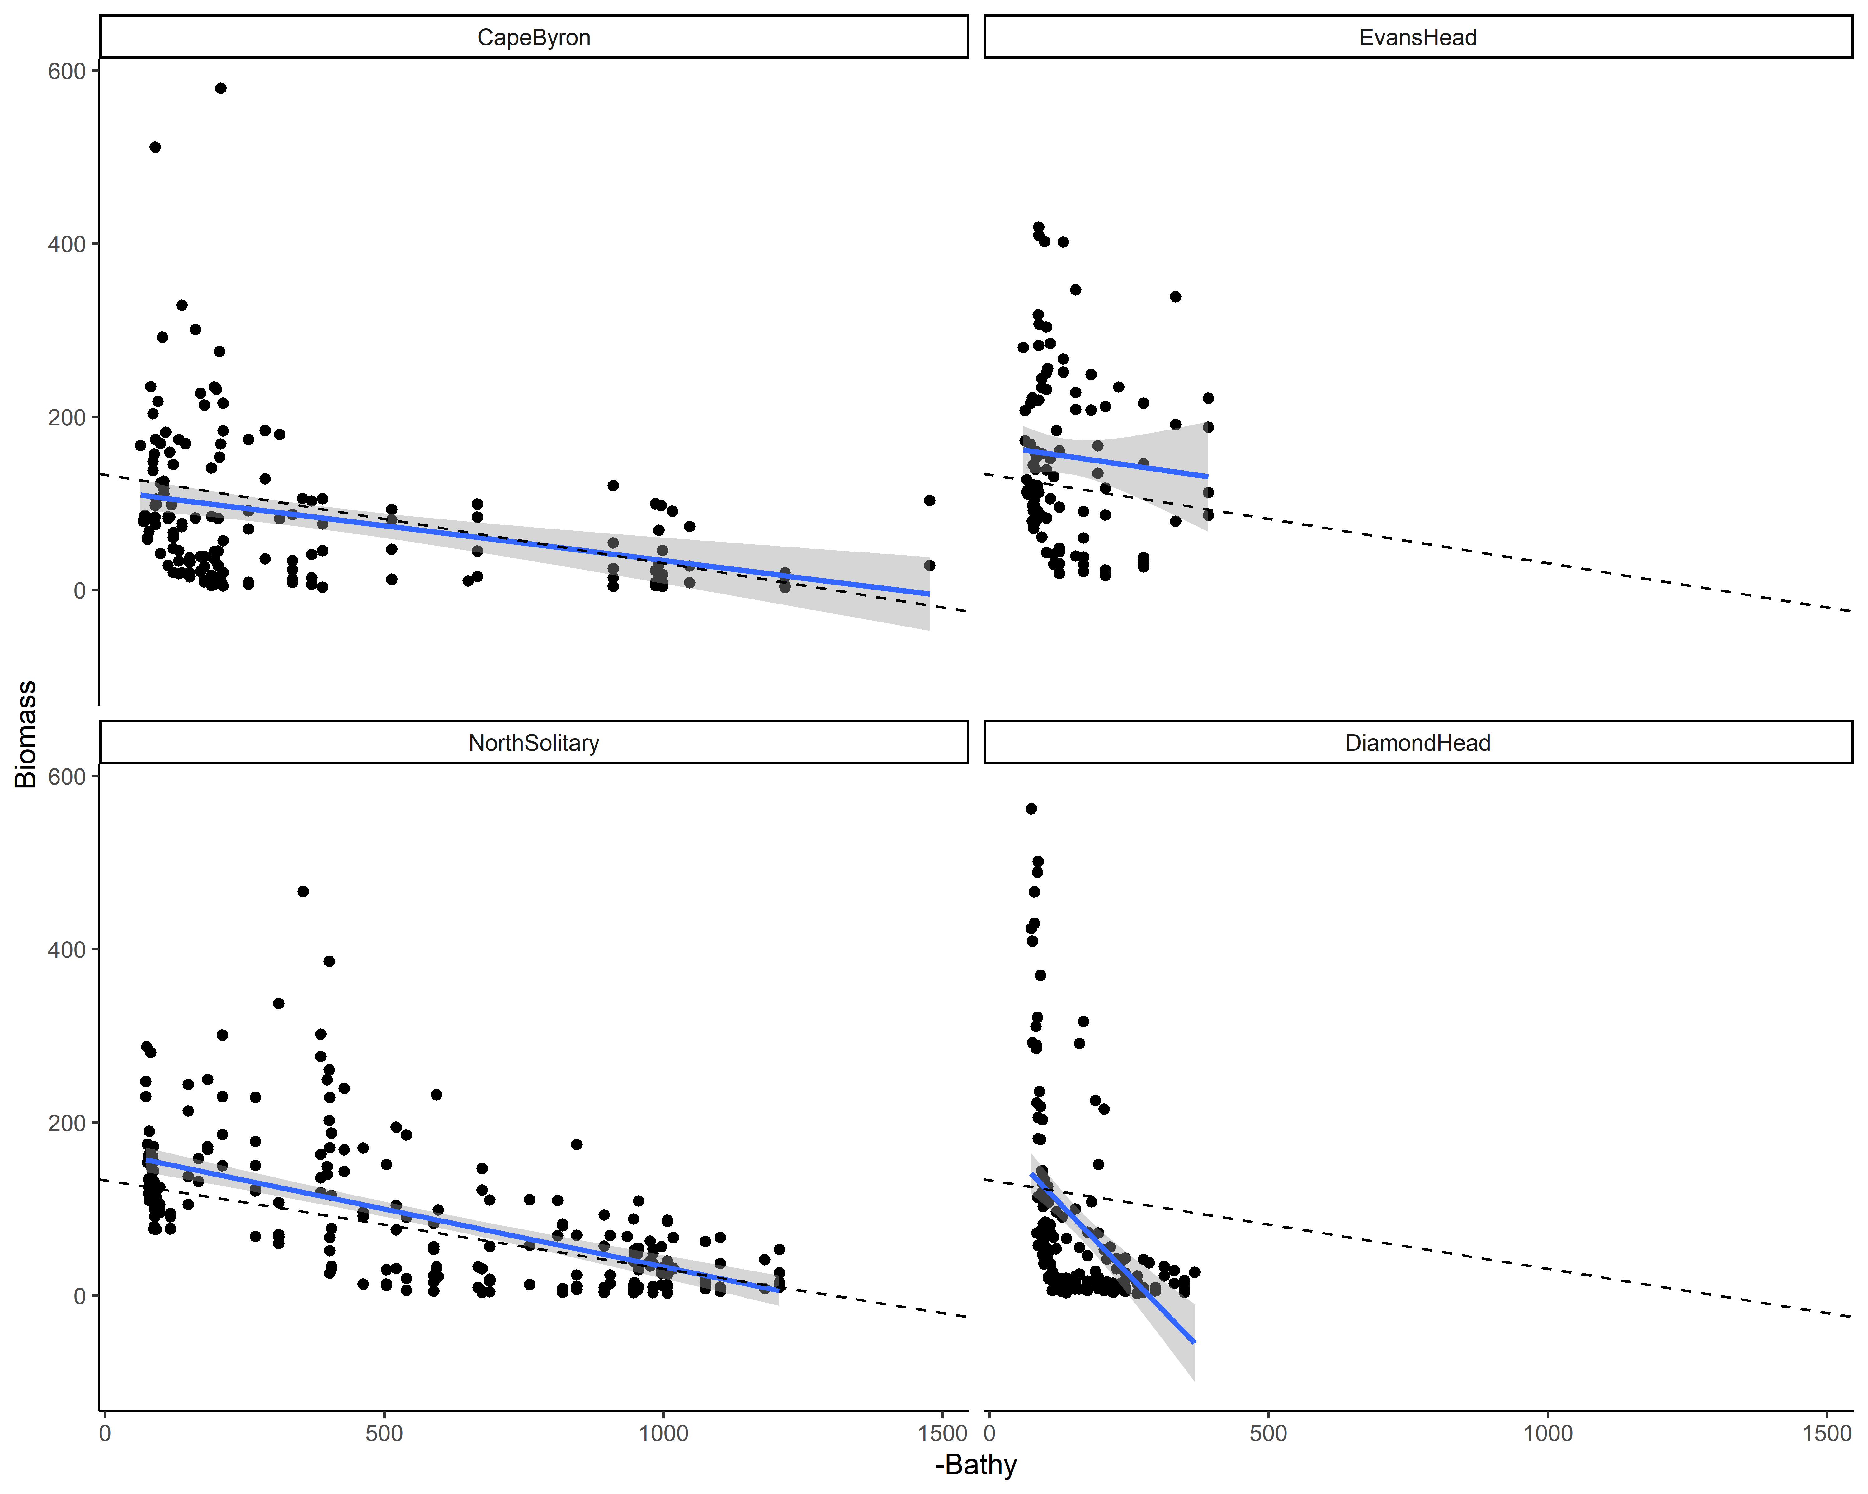
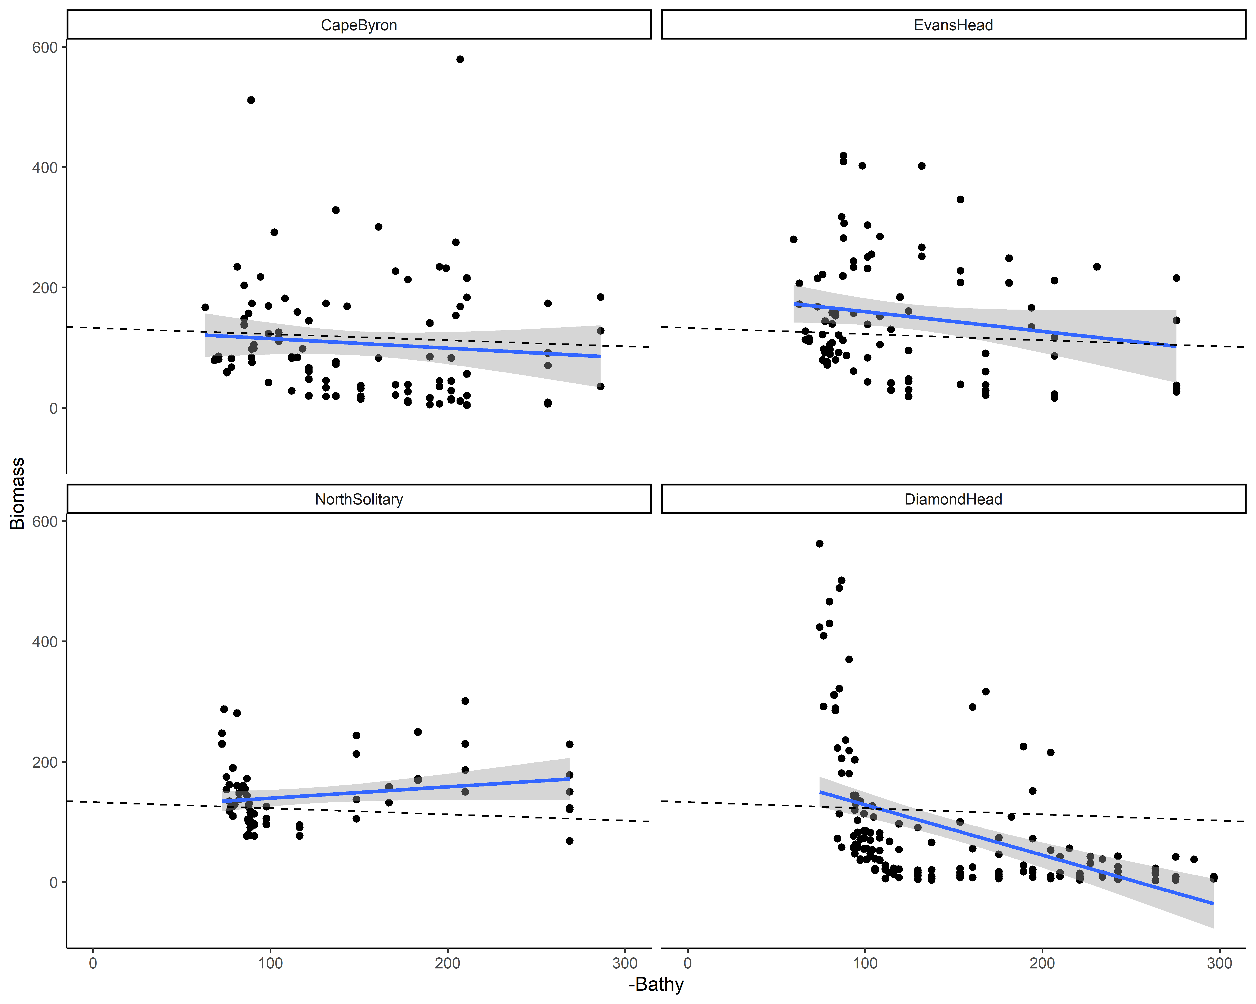
Biomass
Dotted line is overall mean
Full bathymetry x-axis
Reduced x-axis to 300m

Slide 33
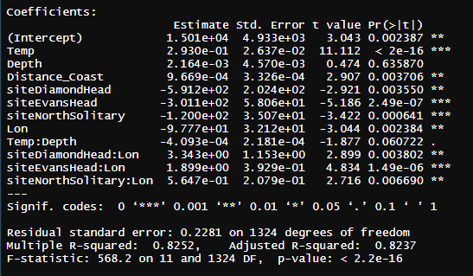
Zooplankton Biomass models
log10(Biomass) ~ Temp * Depth + Distance_Coast + site * Lon, data = mydataX)

Slide 34
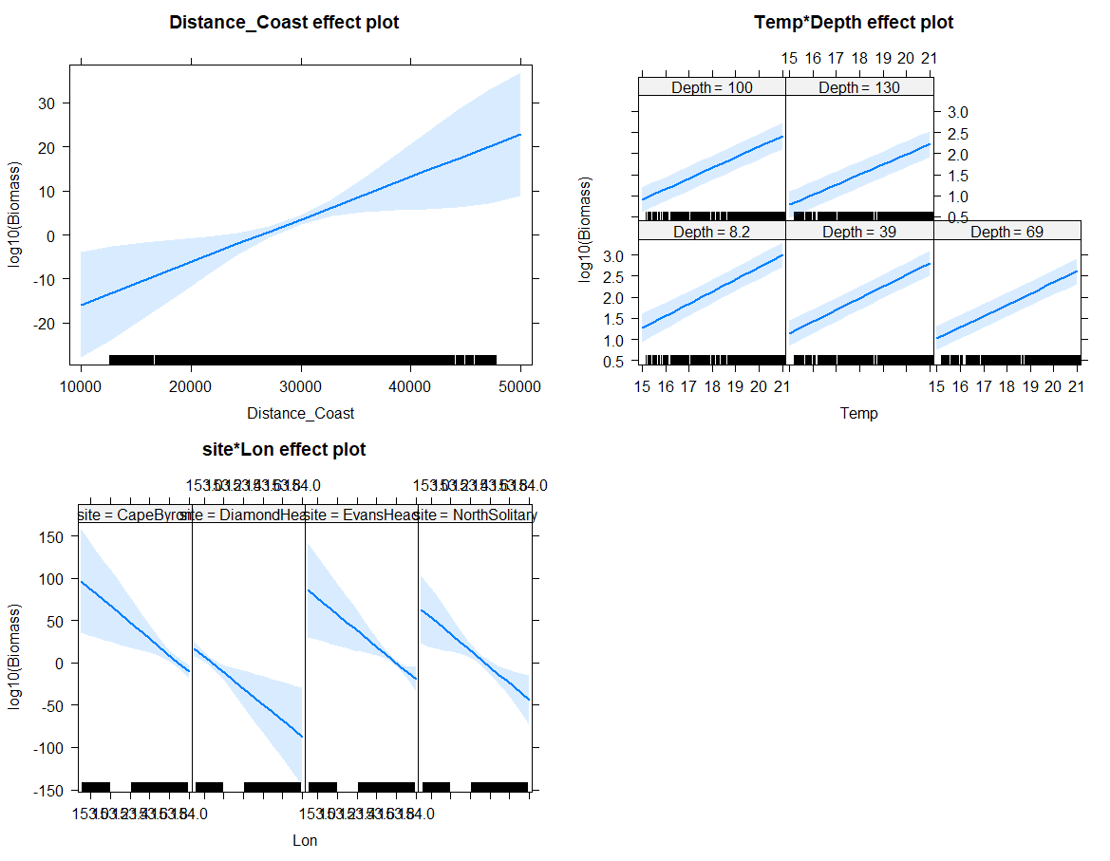

Slide 35
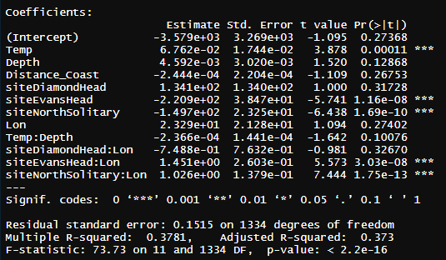
Pareto Slope Model
ParetoSlope ~ Temp * Depth + Distance_Coast + site * Lon

Slide 36
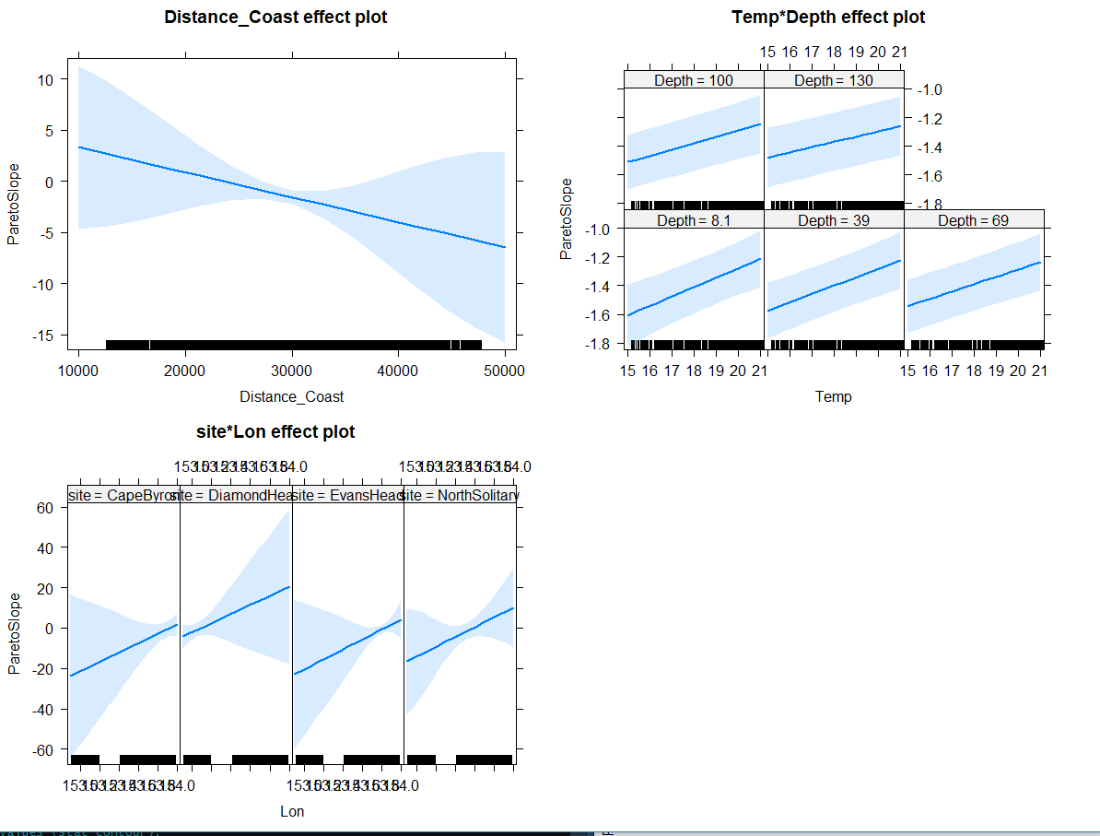

Slide 37
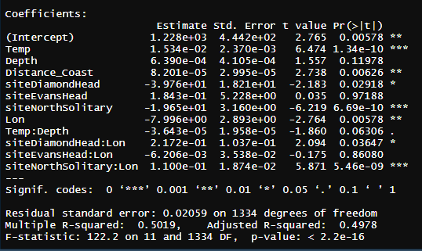
GeoMn Size
GeoMn*1000 ~ Temp * Depth + Distance_Coast + site * Lon, data = mydata

Slide 38
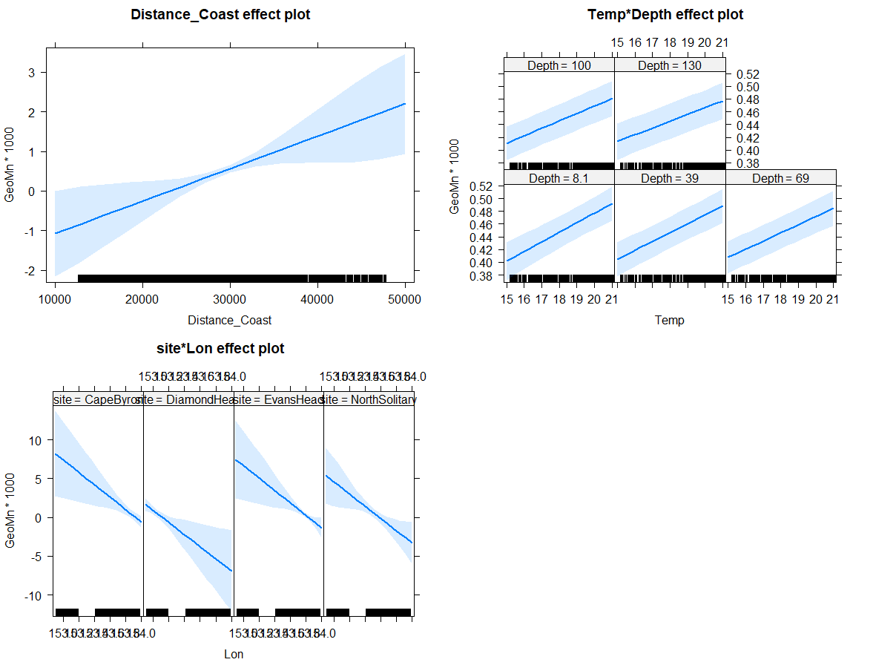

Slide 39
Larger context (not for today)
How typical are the observations seen in these transects?
Temp and Sal
Chl-a
IMOS NRS Moorings
Gliders
Satellite data

Slide 41


Slide 42


Slide 43

MODIS Chl_a

Slide 44
T-S Plot all depths (CTD)

Slide 45
TS Plot by log₁₀(Biomass)

Slide 46

TS Plot by log₁₀(Biomass) top 50m

Slide 47

TS Plot by log₁₀(Biomass) below 50m

Slide 48

TS plot by Depth

Slide 49

TS plot by Nitrate

Slide 50




U vectors
m s⁻¹
m s⁻¹
m s⁻¹
m s⁻¹

Slide 51
U vectors – shoreline rotated (m s⁻¹)

Slide 52




V vectors
m s⁻¹
m s⁻¹
m s⁻¹
m s⁻¹

Slide 53
V vectors – shoreline rotated (m s⁻¹)

Slide 54

ADCP Velocity on a map

Slide 55



Nitrate

Slide 56



Silicate

Slide 57



Oxygen

Slide 58



Oxygen utilisation (expected – observed)
um/kg
Positive = respiration (lower O₂ than expected)
Negative = photosynthesis / production
um/kg
um/kg

Slide 59



Salinity

Slide 60



Temperature
Deg C
Deg C
Deg C

Slide 61



Chl_a

Slide 62



Chl_a top 200m

Slide 63



Nitrate

Slide 64



Silicate

Slide 65



Oxygen

Slide 66



Oxygen utilisation (top 200m)
um/kg
Positive = respiration (lower O₂)
Negative = photosynthesis / production
um/kg
um/kg

Slide 67



Salinity

Slide 68



Temperature

Slide 69

Zooplankton Biomass temperature contours

Slide 70
Zooplankton Biomass

Slide 71




NBSS Slope

Slide 72
Pareto Slope

Slide 73

Abundance

Slide 74




Abundance

Slide 75
Geometric Mean Size

Slide 76
Wind Stress
DH
EH
CB

Slide 77

Modelling Zooplankton Biomass
Call: lm(formula = Biomass ~ Temp + Salt + Depth + site + Distance_Coast, data = mydata)
All variables significant except Salinity (P = 0.25)
Adj R² = 0.58
No autocorrelation taken in account ☹

Slide 78

Modelling Pareto Slope
Call: lm(formula = ParetoSlope ~ Temp + Salt + Depth + site + Distance_Coast, data = mydata)
All variables significant except Depth (P = 0.25)
Adj R² = 0.33
No autocorrelation taken in account ☹

Slide 79
Expectations
Areas of upwelling should have higher nutrients and plankton abundance
Areas offshore (open ocean water) should have slopes closer to -1
Southern sites should have higher biomass (colder water influence)

Slide 80
Patterns
Inshore North Solitary shows some upwelling + higher nutrients + biomass
North Solitary, Evans Head and Cape Byron have high surface biomass offshore (but not abundance?) – this is weird Data error
Abundance (and biomass) increases towards the shelf (I think this is common but relatively unpublished?)

